Slide 1
FREAKY FRIDAY
Humans (Homo sapiens)
Throughout time, humans have evolved to become one of the most successful organisms on Earth, but they also have weird and sometimes unwanted traits leftover from evolution as well:
We lost the ability to make our own Vitamin C (while other organisms except birds and apes can), which means when we don’t eat enough fruit, we have weakened immune systems.
Our urinary tract is very close to a very unhygienic place…
The ability to stand upright led to woman having more complications during birth, spinal complications, and foot pain (too much weight!)
As humans are social creatures, it also makes them very suspicious of people “outside” their own group.
The human eye is built backwards so that light must travel through lots of “stuff” before it hits out light receptors, which means we don’t have as good of vision as other organisms and have blind spots.
Since humans have these flaws, why hasn’t evolution just gotten “rid of them”?

Slide 2
FREAKY FRIDAY
Bringing Back Extinct Animals
Preserved fossils contain fragments of DNA.
By collecting thousands of fragments, you can begin to piece back together whole genomes (=all the DNA of an organism)
If all the DNA can’t be put back together then small fragments could still be inserted into related species to bring back some traits.
However, because DNA decays over time, the only fragments large enough to work with are for animals that have gone extinct within the last 10,000 years: like mammoths, passenger pidgeons, dodos, etc.
Some animals, like the gastric brooding frog, are close to being brought back. Scientists already have an embryo prepared.
So, should scientists bring back extinct animals? What challenges do they face if they do bring them back?

Slide 3
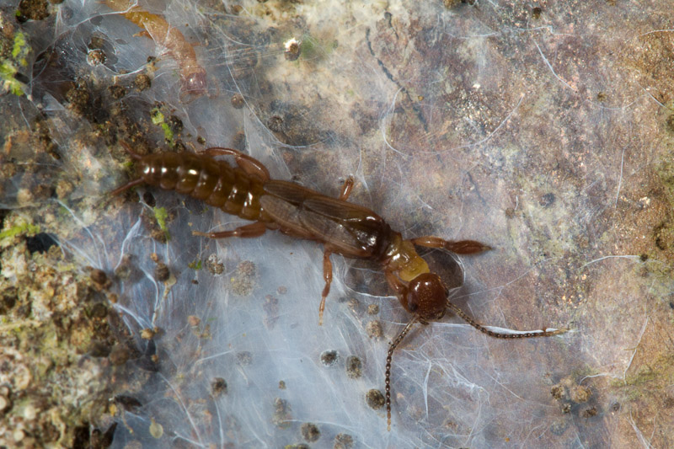
FREAKY FRIDAY
Webspinners (Embioptera)
Females are wingless while males can fly.
Both sexes have large front legs which contain silk-producing glands.
Each leg has over 150 silk-producing ejectors.
They make large silk “tents” on tree trunks which prevents them from being hunted by organisms as it is so airtight it can keep out smells and water.
Some females camouflage their tent by adding leaves and bark.
Females protect their eggs after laying them, a trait often seen in most insects. (Are there examples of this in this room?)
After their pupa stage, adult males never eat, they just mate and then die.

Slide 4
FREAKY FRIDAY
Axolotl (Ambystoma mexicanum)
Also known as the Mexican Salamander
It is an amphibian, but it does not develop lungs, instead it keeps its gills throughout its life and must remain in water.
A threatened species that can no longer be found in the wild.
It is currently a widely studied organism due to it’s ability to regenerate its limbs, parts of its brain, and receive transplants
Axolotls can do this in about a month.
Axolotls can receive transplants from foreign species, like frog eyes, and can actually make them functional. They even can receive full head transplants from other axolotls.

Slide 5
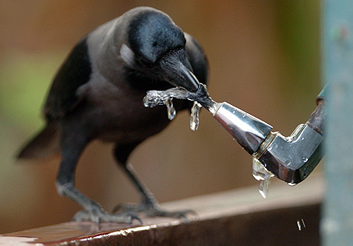
FREAKY FRIDAY
Crows (Corvus)
Includes around 40 species, including the common raven (Corvus corax).
A group of crows (or ravens) is called a murder.
Their intelligence has been measured to be as high as apes’.
What makes them so intelligent? Here are some examples:
They can remember faces of humans who harm them for years.
They can communicate and tell other crows who harmed them.
Some murders of crows will avoid areas where other crows were killed for over 50 years (passing on this info for generations)
Crows will fake hide food to fool other animals.
They can use tools to solve complex problems.
City crows drop nuts on busy roads so cars will crush them.

Slide 6
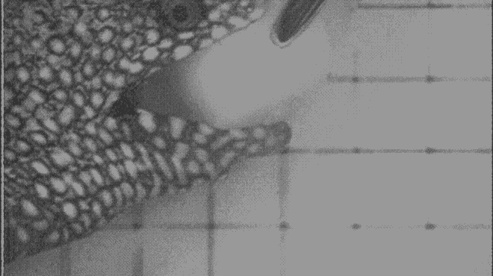
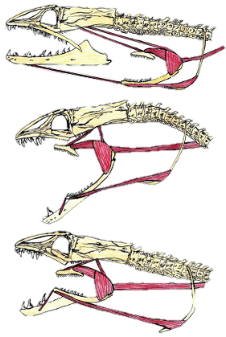
FREAKY FRIDAY
Morey Eel (Family: Muraenidae)
Over 200 species in this family, both salt and freshwater varieties.
Extremely thin bodies, but can grow to over 10 feet long.
Has pharyngeal jaws, which are located down inside the throat.
Most Morey’s eat fish that move and thrash when attacked so these jaws evolved as a 2nd “hand” to keep their food from escaping and forcing it down their throat.
Also, their larvae are hard prey to catch because they are completely transparent.
What movie alien did this eel inspire?

Slide 7
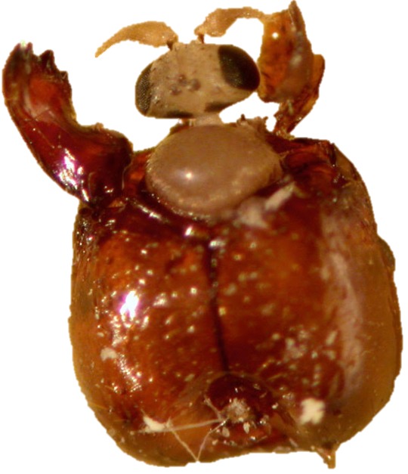
FREAKY FRIDAY
Decapitating Fly (Pseudacteon formicarum)
Two types of ants, red and black fire ants, cause over $1 billion worth of damage yearly due to agricultural damage.
A scientist in 1994 began studying these ants to see if they had any natural predators.
When he examined specimens he collected, he found maggots growing inside the heads of some of the ants.
It turns out these previously un-studied flies use their ovipositor (“egg depositor”) to drill into the ant’s legs and lay their eggs there.
The new larva crawls up to the head (inside the ant) and then stays there for 2 weeks before hatching out. ***This whole time the ant behaves normally.
24 hours before hatching the fly takes control of the ant’s mind and makes it walk to a moist, cool area (usually under leaves).
Then the fly releases chemicals that dissolve the ant’s neck membranes to the head falls off which allows the fly to safely hatch out.

Slide 8
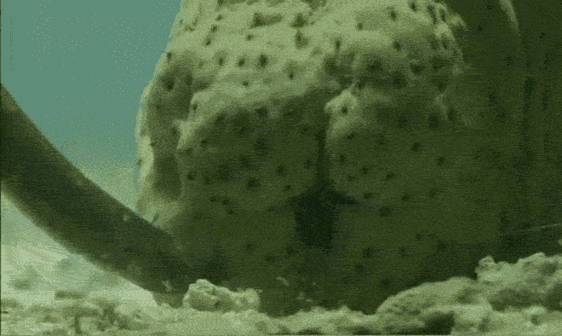
FREAKY FRIDAY
Pearlfish (Encheliophis)
Pearlfish are long, slender fish that live in every major ocean at depths near 2,000 m and can grow to be around 20 inches long.
Most pearlfish live are commensal and live inside clams (hence the name pearl), starfish, and sea cucumbers, however some are parasitic.
One genus, Encheliophis, invade the anus of bivalves and echinoderms and live inside them and mate, or to make more room, eat the reproductive organs of the host.
The reason these hosts don’t just close their anus to prevent invasion is that they are protostomes, meaning their anus is also their mouth.
Sea cucumbers have evolved two neat defenses: evisceration and anal teeth.
Why would the pearlfish have evolved this adaptation?

Slide 9
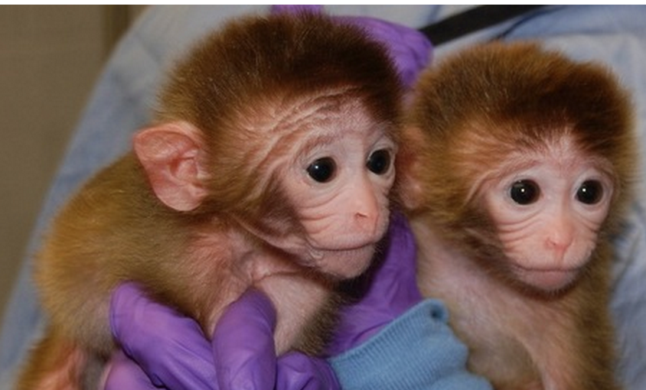
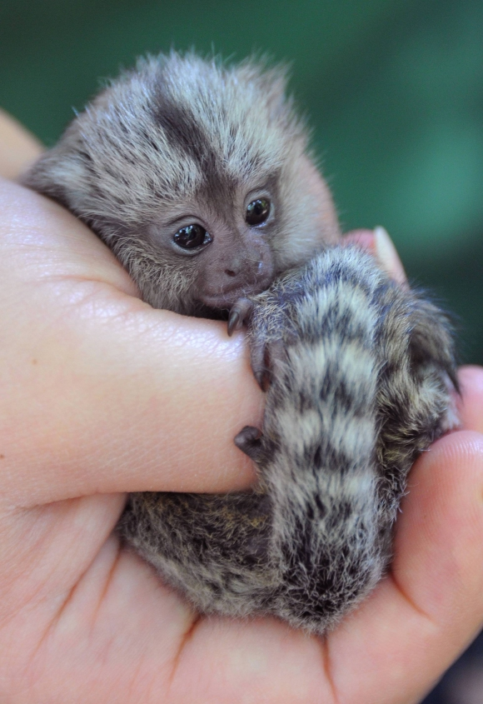
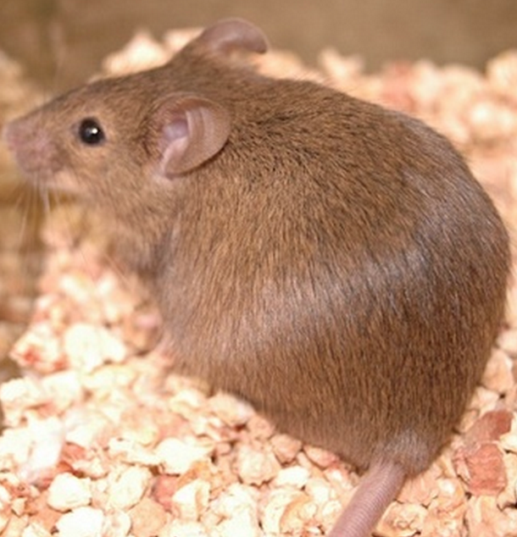
FREAKY FRIDAY
Chimeras
Chimeras are single organisms made of genetically DIFFERENT cells.
In Greek mythology a chimera was a fire-breathing animal that was part lion, goat, and snake.
A human chimera can occur when two zygotes fuse together to form one organism.
Some mothers absorb some of their fetus’ cells and become chimeras.
95% of marmosets are chimeras.
Angler fish males attack and are eaten by females to become a chimera.

Slide 10
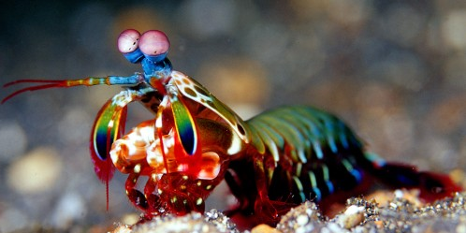
FREAKY FRIDAY
Mantis Shrimp (Stomatopoda)
Have the most complex eyes in the animal kingdom, with the ability to see in color WAY better than humans.
Humans have 3 color receptors (red, blue, green), Birds have 4 (+ UV) and Mantis Shrimp have 16 (!) photoreceptors and can see UV, visible, and polarized light.
They also have the ability to perceive depth perception with only ONE eye, using their 3 pupils per eye.
They also posses clubbed claws capable of striking or “punching” prey at over 23 ft/s (as fast as a .22 caliber bullet) and with the acceleration of 102,000 m/s² (10,400 g’s).
Why might Mantis Shrimp need the ability to see in 16 different ways (13 more than humans)?

Slide 11
FREAKY FRIDAY
Archer Fish (Toxotes)
This family and genus consists of 7 species of fish all who hunt by shooting water from their specialized mouths.
Typically hunt insects smaller than 3 cm and are deadly accurate, almost always hitting on the first shot.
They have a groove on the base of their mouth which they place on the surface of the water and push their tongue on the groove to create a water stream.
They have the remarkable ability to compensate for the refraction of light as it passes through the water when aiming by rotating their eye.
They typically spit at prey at a mean angle of about 74° with the water but can still aim accurately between 45 and 110°.
Young archer fish learn to hunt in schools.

Slide 12
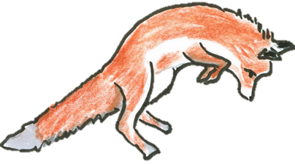
FREAKY FRIDAY
Red Fox (Vulpes vulpes)
Can stalk a mole, mouse, vole, or shrew from a distance of 25 feet, which means its food is making a barely audible rustling sound, hiding almost two car lengths away.
One region of foxes prefer to jump in a particular direction, toward the northeast. *Using magnetic fields as their compass.
Most of the time, most foxes miss their targets and emerge covered in snow but when pointed northeast they kill on 73% of their attacks. *Only 18% when pointed in other directions
Their magnetic sense is like walking with a flashlight attached to your head projecting a beam. Animals know how to measure the distance between themselves with a sort of “magnetic” beam. When foxes hear a sound under the snow they search for the “sweet spot," where the angle of the sound hitting their ears matches the slope of the Earth's magnetic field.

Slide 13
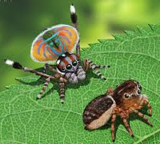
FREAKY FRIDAY
Peacock Spider (Maratus volans)
Only found in rare parts of Australia. The newest species was discovered in 2012.
Male peacock spiders have a circular flap extension on their abdomen that has a variety of bright colors, which is why they have this name.
Used to attract a females (who are not colored) attention, they also perform a dance with quick movements.
The research still has yet to support their love of the YMCA.
They are NOT venomous.

Slide 14
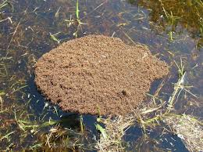
FREAKY FRIDAY
Fire Ants (Solenopsis)
Commonly confused to be large ants, these ants are small but extremely aggressive. They can swarm a predator in seconds.
Male and Female fire ants capable of reproduction are called alates and have wings.
Fire ants are capable of stinging and while they are not deadly, they can cause intense pain.
Fire acts can form new colonies through flight, walking, or forming balls of dirt on water and floating to new locations.
Ants form hills that are capable of stretching miles and contain millions of ants.

Slide 15
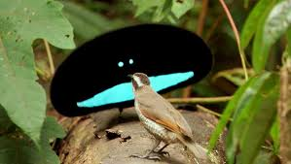
FREAKY FRIDAY
Superb Bird of Paradise (Lophorina superba)
This bird is a member of the family, birds-of-paradise, in which most of the males have very colorful feathers which is called sexual dimorphism.
Female Superb Birds of Paradise are extremely rare so competition for mates is very high.
The male Superb Bird of Paradise attracts females with a loud call, then dances by bouncing back and forth while surrounding the female and exposes his chest shield which resembles a cartoon face.
Even after all of this, females are still choosey: they reject usually 15-20 males before picking a mate.

Slide 16
FREAKY FRIDAY
Stoat (Mustela erminea)
This relative of the weasel lives in northern climates, mostly in Canada, Europe, and Russia.
This animal displays a common habit, which is being affected by a photoperiod (=time length an organism is exposed to day light)
The stoat will dash and jump around so fast that the prey, usually rabbits, become hypnotized by watching that dance and forget that the predator is coming closer to them.

Slide 17
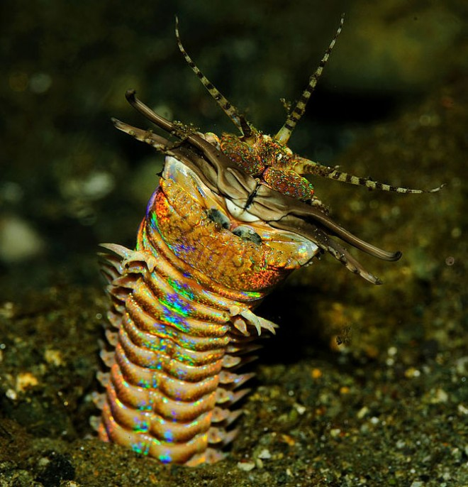
FREAKY FRIDAY
Bobbit Worm (Eunice aphroditois)
This aquatic worm buries itself in ocean beds and can grow to be over 10 feet long.
It possesses 5 antennae near its mouth which allows it to catch it’s prey at speeds faster than any aquatic animal, typically fast enough that many of their victims are cut in half.
It possesses a toxic venom that paralyzes it’s prey immediately and then drags the prey underneath the mud to feast on it.
Recently, they have become an issue in large public aquariums, because they have been eating all the fish or slicing them in half.

Slide 18
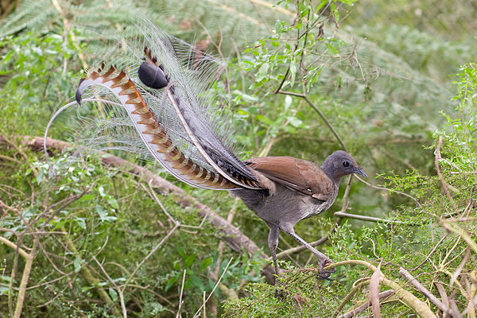
FREAKY FRIDAY
Lyrebird (Menura novahollandiae)
This bird can mimic practically any sound it hears.
They are almost the largest birds in their order, which also includes sparrows. The only larger bird in their group are ravens.
Their breeding season is from June-August, where they sing a lot.
During this time they sing for 4 hours a day in which they can imitate almost any type of sound, including chainsaws, car alarms, rifle-shots, camera shutters, dogs barking, and even the human voice.
While females can mimic sounds too, only males do it for a long time, most of the time for several hours in one spot. *Research has shown that females choose males who mimic the most bird songs. Why would females prefer this adaptation of the males?

Slide 19
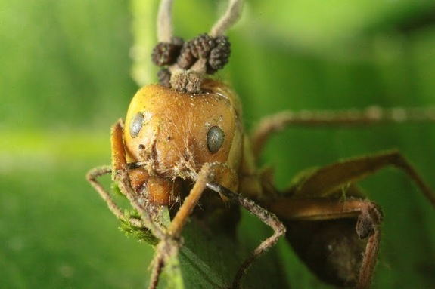
FREAKY FRIDAY
Zombie Fungus (Ophiocordyceps)
Insects (commonly ants) are invaded by a parasitic fungus.
Each species of fungus has coevolved to infect one species of insect.
The fungus builds up enough pressure to fill a 747-airplane tire and burst their DNA into the living insect.
The fungus grows into the insects brain to control their mind.
The now “zombie ant” directs the ant to face northwest, roughly 25 cm off the ground on a leaf. *Experimentally shown to be the best position for humidity and temperature for the fungus to survive ← AMAZING!)
Then the fungus fruiting body grows through the insects exoskeleton and bursts, raining down thousands of new spores on new victims.

Slide 20
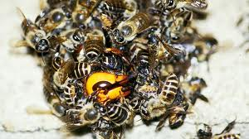
FREAKY FRIDAY
Japanese Honey Bees (Apis cerana japonica)
An extreme example of predation, these bees are hunted by Giant Asian Hornets.
The hornet can cut honeybees, their most common prey, in half (at a rate of 40/min) with it’s large mouth-pincers.
The Giant Asian Hornet (Vespa mandarinia) is the world’s LARGEST hornet (2-3 in) and has a sting venomous (Venom = injected; poison = absorbed) enough to kill humans.
The honeybees have evolved a defense mechanism in which they swarm an invading hornet and vibrate so fast they actually produce enough heat to cook the hornet alive at temperatures near 115º F.
Even though some bees die during this attack, why do they still do it?

Slide 21
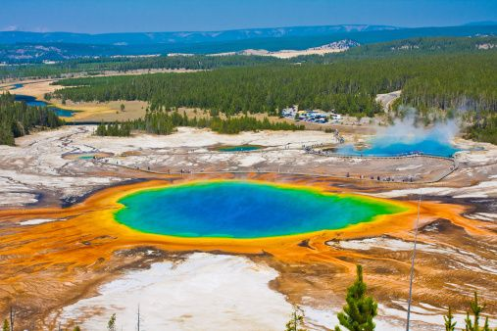
FREAKY FRIDAY
Archaebacteria
An entire domain (= the highest/largest classification of organisms) of organisms.
Commonly called the extremophiles (-phile = love), they live in some of the most extreme environments:
Halophiles = live in salty places.
Methanogens = live in apoxic (NO oxygen) areas and produce methane.
Yes, these organisms live in your intestines and are responsible for your stinky “gas”.
Crenarchaeota = live in boiling hot springs (>100°C) and use ammonia (NH₃) for energy, instead of oxygen. (Probably one of the first organisms to evolve)
Thermoplasmatales = live in acid pools in abandoned mines (with pH’s below 1)
A pH of 1 is the same as battery acid which when exposed to skin immediately causes sever burns.
They live in such unique places that astrobiologists hypothesize that if life is ever found on other planets, it would be archaebacteria.

Slide 22
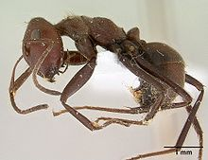
FREAKY FRIDAY
Carpenter Ants
Use the mechanism of autothysis (-thysis= sacrifice) which is when an organism explodes itself to fight off predators.
When attacked by predators such as other species of ants and spiders they tighten a group of muscles around an organs to make them burst.
The bursting releases a toxic glue that sticks to the predators; as well as excrement.
Why is autothysis an adaptation? (even though the ant doesn’t survive)
Altruism (=behavior that benefits a related species, at a cost to itself)

Slide 23
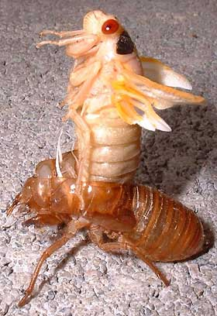
FREAKY FRIDAY
Cicada
Over 2,500 different species.
The Magicicada cicadas bury themselves underground for 17 years.
While underground they feed on the water in tree roots using their straw-like mouth.
They come above ground in July for 6 weeks to mate and lay eggs, th en they die.
They have 2 genes (= a piece of DNA that codes a trait): a 17 year dominant gene and a 13 year recessive gene.
Why do you think some cicadas emerge in 13 years and some in 17 years?

Slide 24
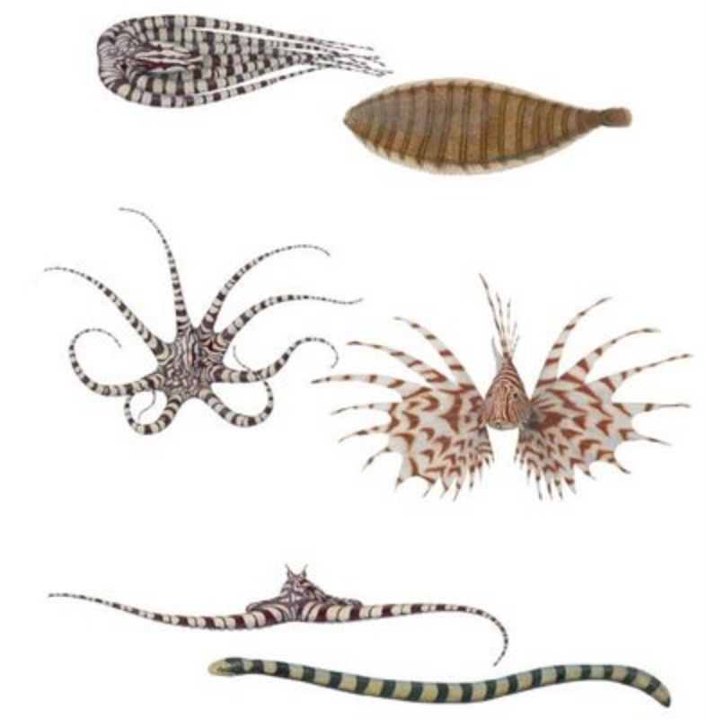
FREAKY FRIDAY
Mimic Octopus
Impersonates live animals.
Has pigment sacs called chromatophores, which allow their skin to change colors.
Pigments = light-absorbing chemical.
Makes a color (plants have chlorophyll)
Mimics to hunt and protect.
Humans have one type of chromatophore, where do you think it is located?

Slide 25
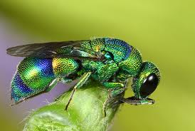
FREAKY FRIDAY
Jewel Wasp
A wasp parasite.
Found in South Asia and Africa.
Uses live cockroaches as food for larva.
Uses its stinger to inject venom into a cockroaches brain to temporarily paralyze it.
Then it controls the roaches brain by pulling on its antenna.
It buries the roach underground, lays eggs in its body, and then lets the new wasp larva eat the insides of the roach
while the cockroach is still alive
What if humans could do that?

Slide 26
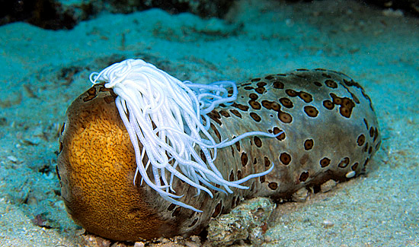
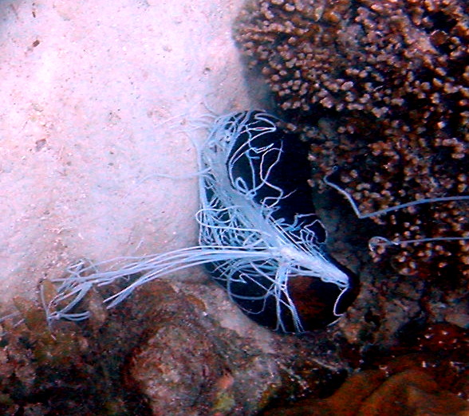
FREAKY FRIDAY
Sea Cucumbers
Sea cucumbers are related to starfish.
They are found on the seafloor all around the world.
When scared a sea cucumber will release its intestines out of its mouth to distract predators and then run away.
Sea cucumbers regrow their intestines within 3 weeks.
What if humans could do that?

Slide 27
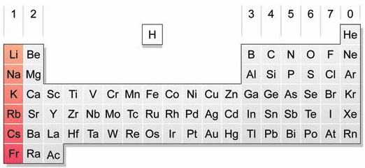
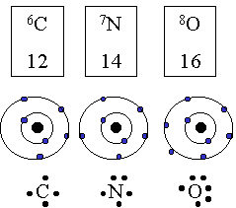
My Chemical Friday
Alkali Metals
The alkali metals are in the first column (group) of the periodic table of elements.
These elements react VERY FAST with water.
These atoms have 1 valence (= outer) electron.
Stable atoms have a complete set of outer electrons (2 or 8), so the alkali metals lose their only valence electron so that they can be stable, which happens so quickly that there is a large release of energy.
*DUE MON: Biology – Assigned Research Tasks for Project
*AP – Ch. 10 Reading Quiz
2 FRQ’s next week (Tues and Thurs)

