Slide 1
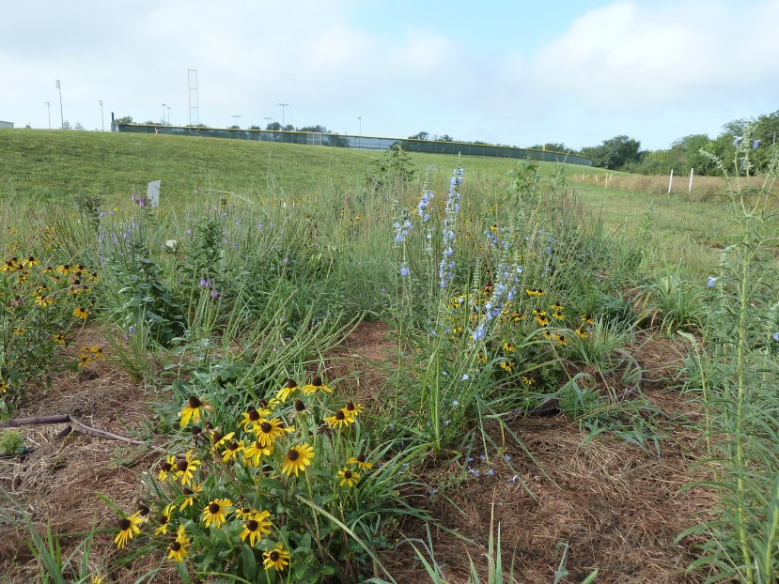
Free State Prairie:
past, present, and future!
Julie Schwarting (Free State High School) and
Helen Alexander (University of Kansas)

Slide 2
National interest in outdoor education
“Dedicated outdoor experiences solidifies ecological
concepts by providing a local framework upon which to test new ideas”
“With enough exposure to their local environment,
students begin to map their bioregion and understand the ecological and socioeconomic benefits of the natural world”
Outdoor learning in formal ecological education: looking to the future. Frontiers in Ecology and the Environment 2014

Slide 3
But how does one actually DO this at a high school?
We are learning…….this last year students at Free
State High School have been actively involved in
prairie restoration
How did this develop?
Julie’s vision

Slide 4
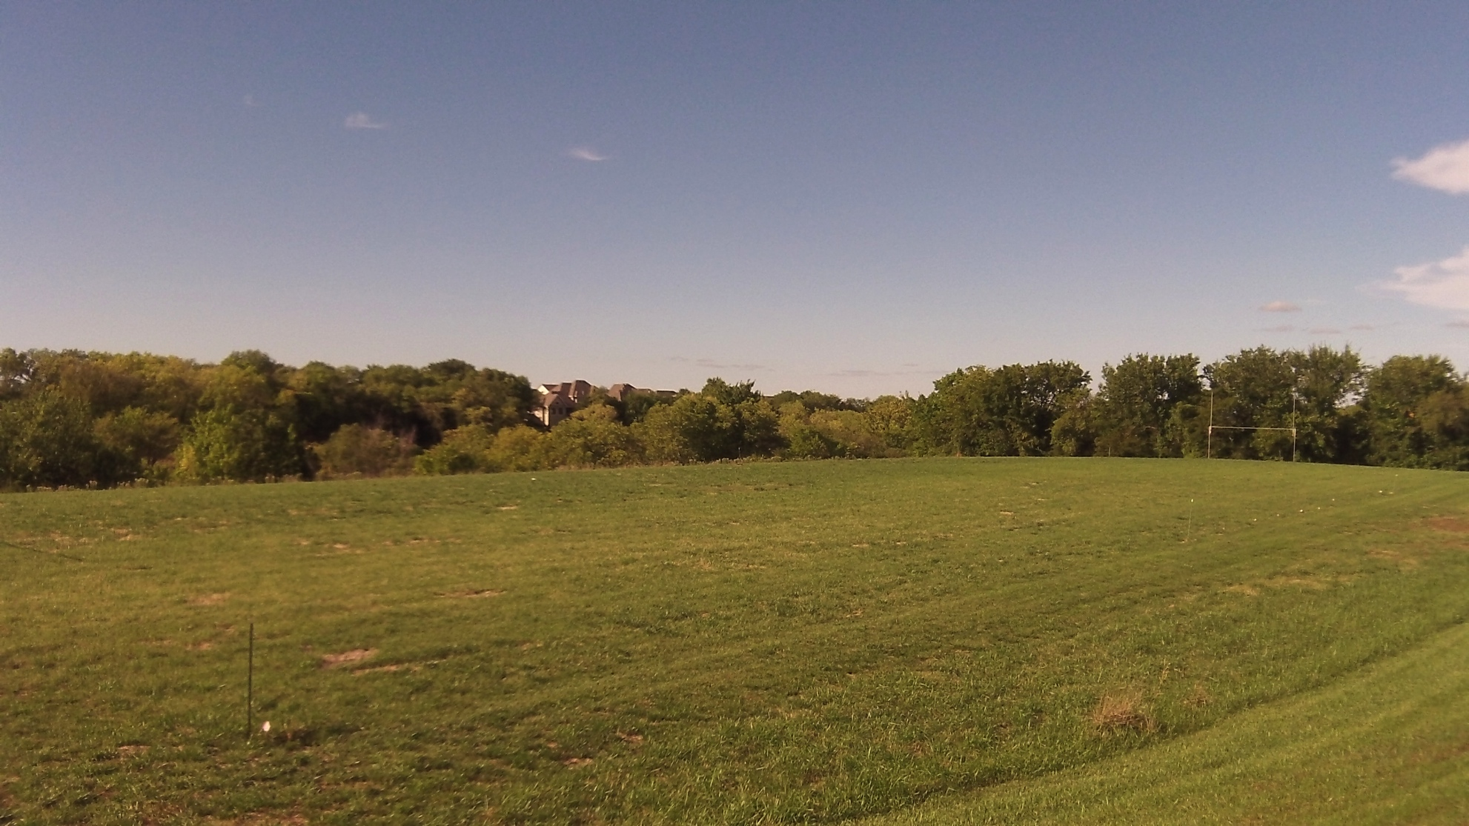
What potential!

Slide 5
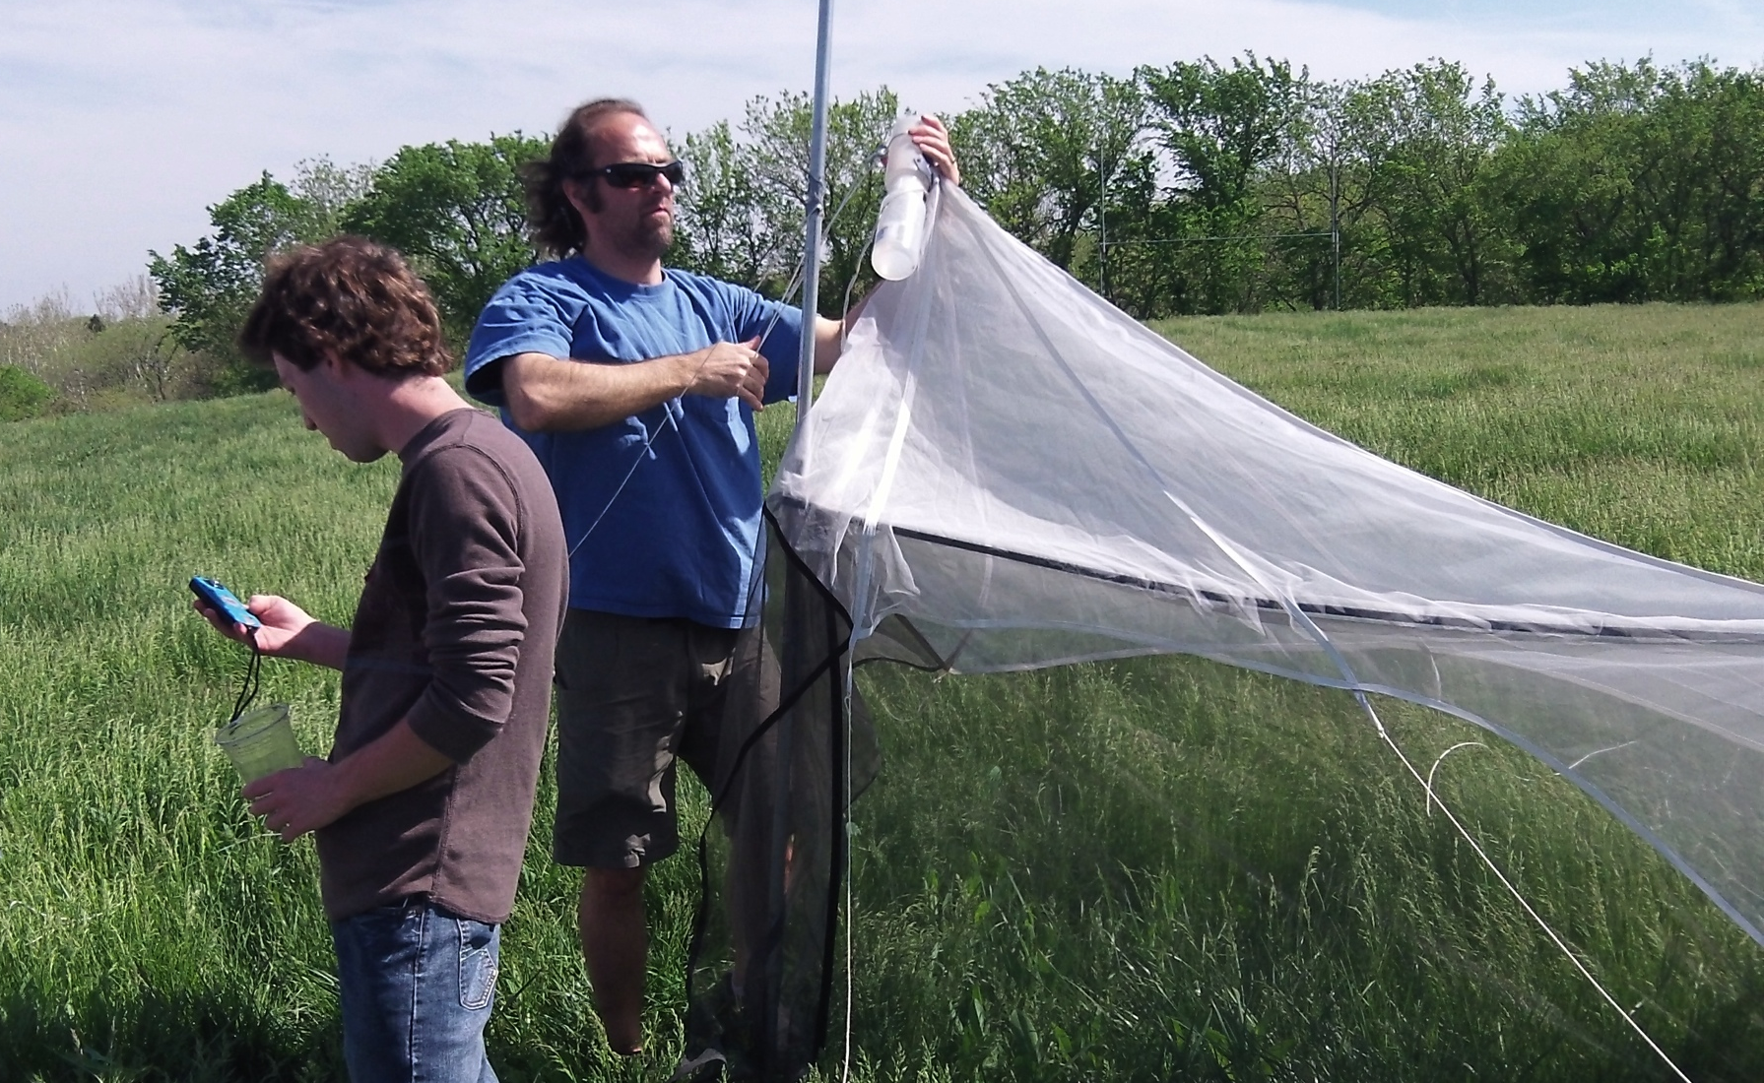
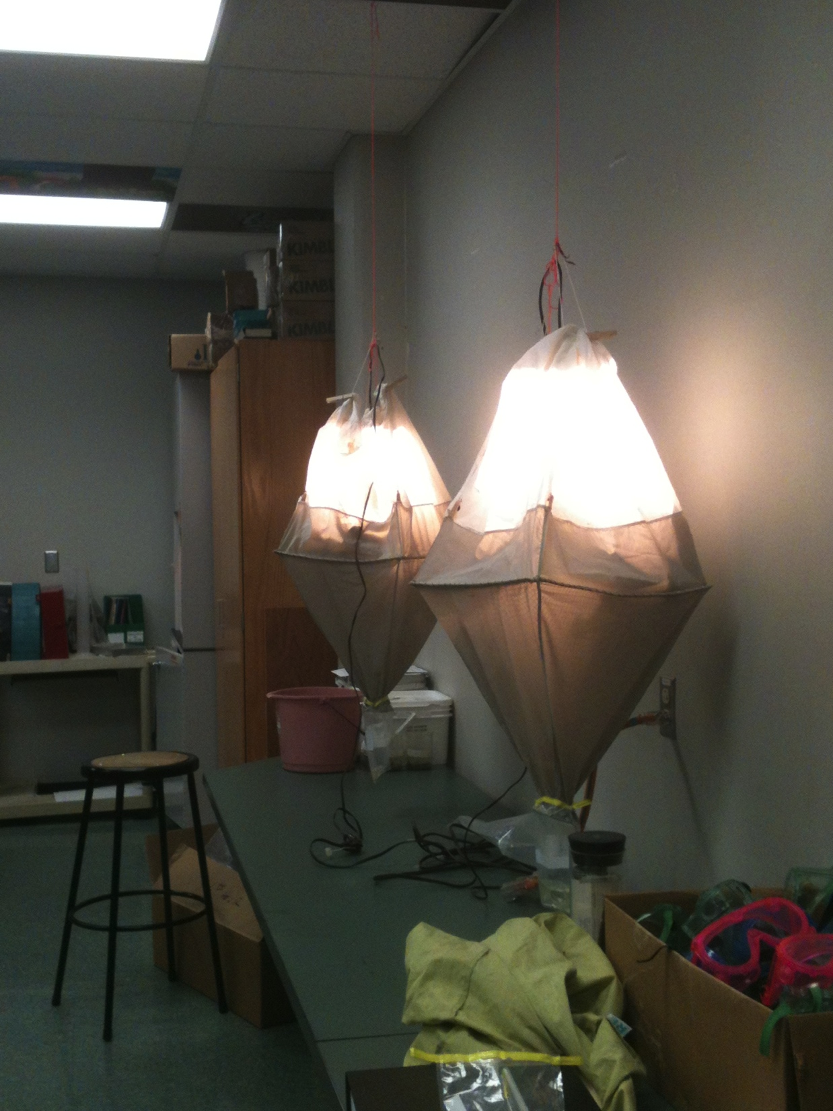
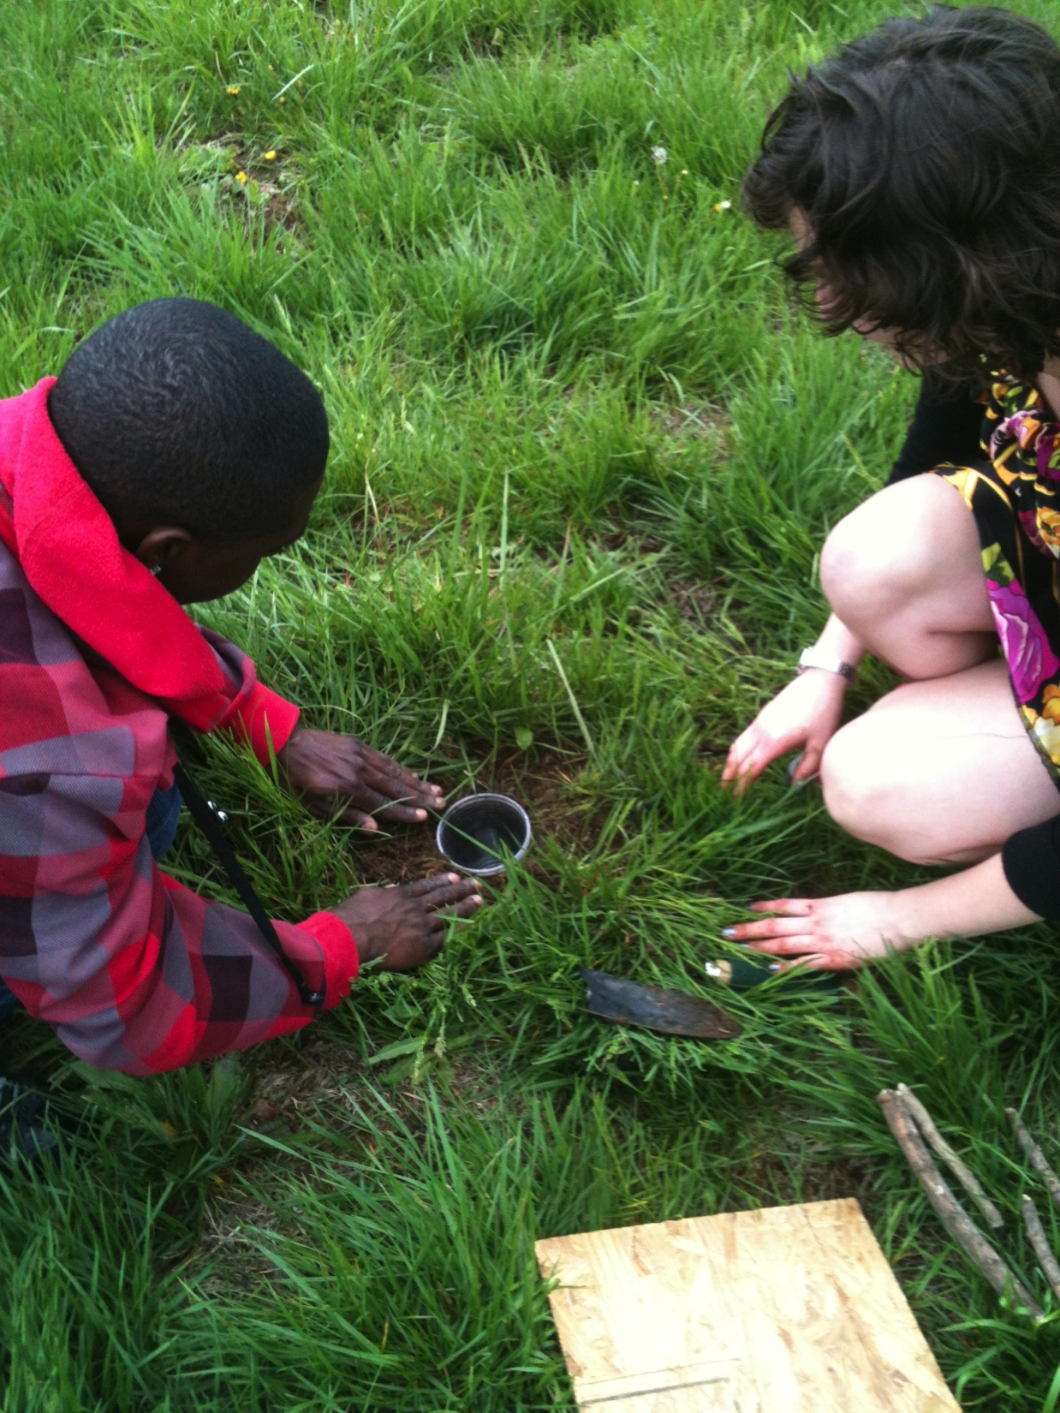
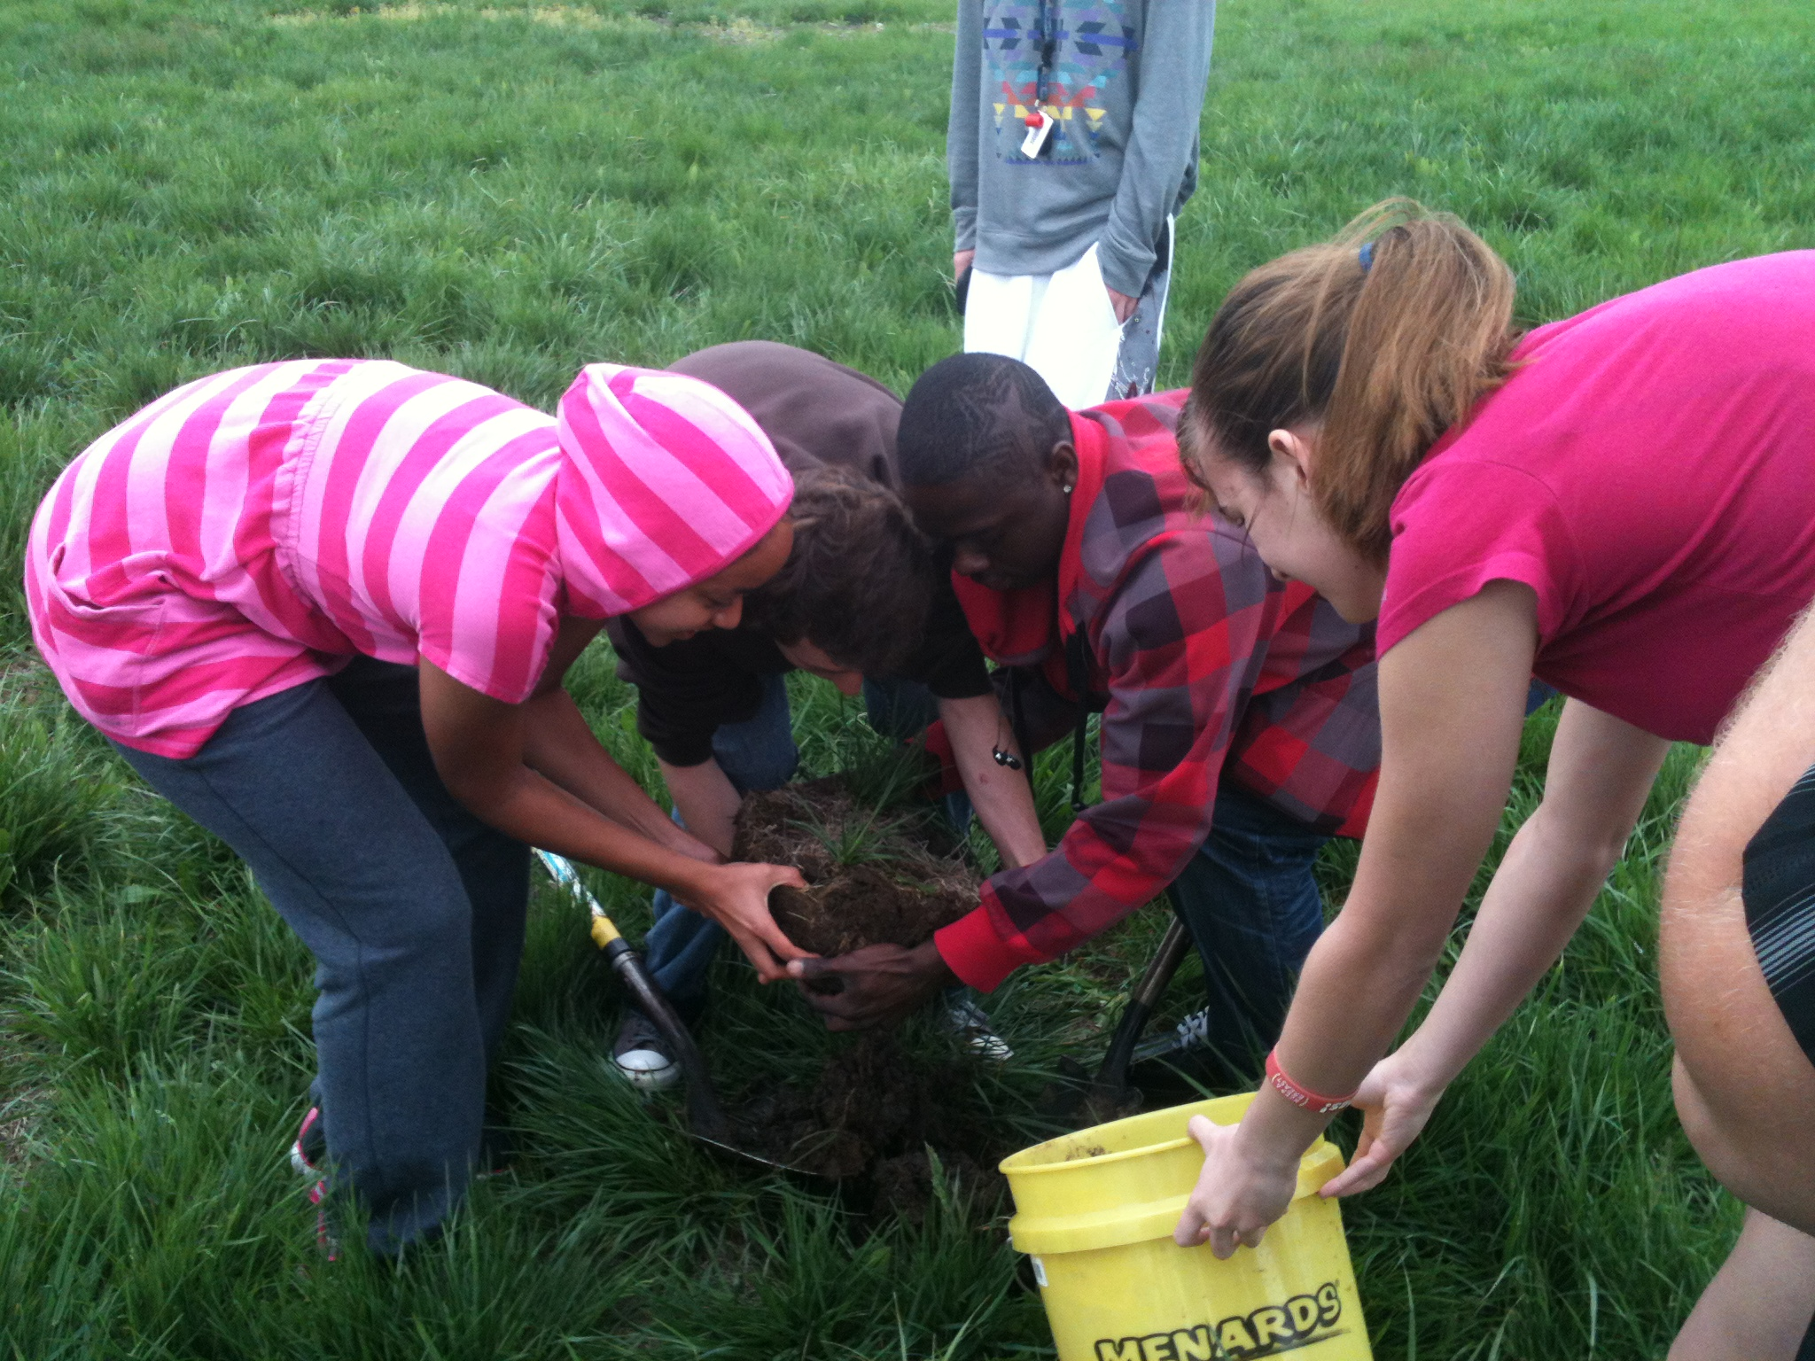
May 2013 Baseline Insect Survey with Zach Falin, KU Biodiversity Institute

Slide 6
Results:
In two days we collected 226 specimens representing approximately 93 species of insects in six orders (not counting flies)!

Slide 7
How did the restoration project develop?
Julie’s vision; Helen’s conservation biology seminar
Funding from Elizabeth Schultz Environmental Fund
and other agencies
Expertise, help, and enthusiasm from many, many
people

Slide 8
Writing a grant helps focus one’s goals:
We addressed 5 problems in our application:
1. Loss of native vegetation in Douglas County.
We are raising a generation of children with little
exposure to the natural world
(but hard for teachers to take children on field trips)
Students are generally unaware of the prairie heritage
of Kansas.
“Inquiry based” education essential for students to learn
problem solving and the essence of science
K-12 teachers and KU researchers rarely have
opportunity to collaborate.

Slide 9
Also considering
Next Generation Science Standards:
HS-LS-2A-C
Interdependent relationships in ecosystems
Ecosystems dynamics, functioning, and resilience
Cycles of matter and energy transfer in ecosystems

Slide 10
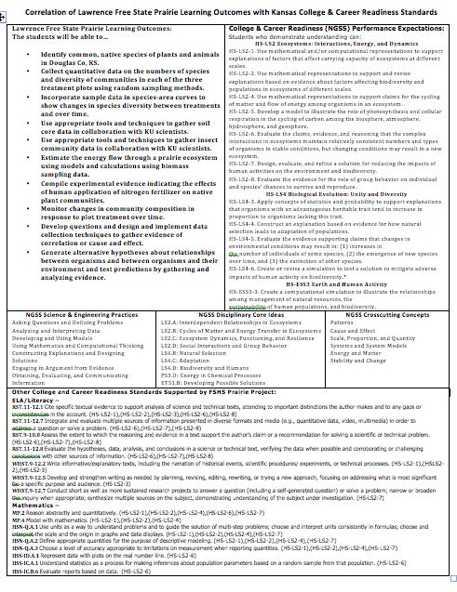

Slide 11
Our proposal: create two environments at
Free State High School
A prairie restoration and community ecology
experiment in an abandoned football field
A prairie demonstration site
next to the prairie restoration/experiment
We were funded! And soon realized that
we had taken on a very BIG task!

Slide 12
Brief history:
Our first goal: A prairie restoration and community
ecology experiment in an abandoned football field
Not just a “planting…”…….but a “real experiment”
that addresses new questions, and provides a
template for other studies
But what kind of experiment?
Details of treatments and design?
Lots of meetings/ideas/plans with KU and Indiana
University scientists--- changed plan several times

Slide 13
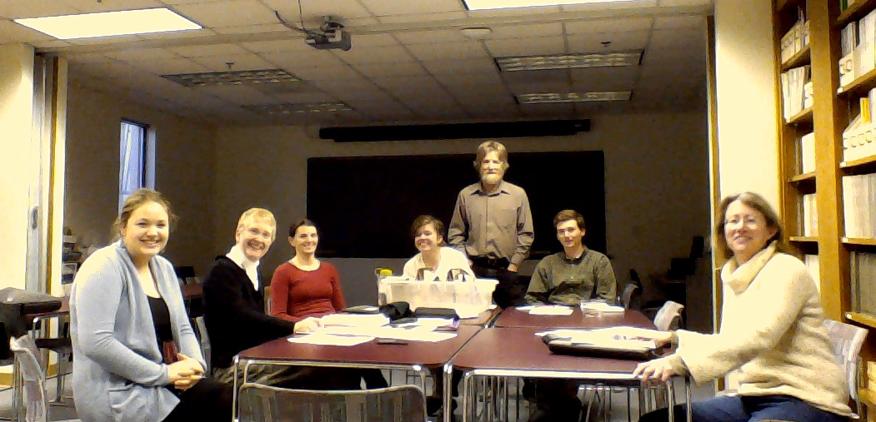
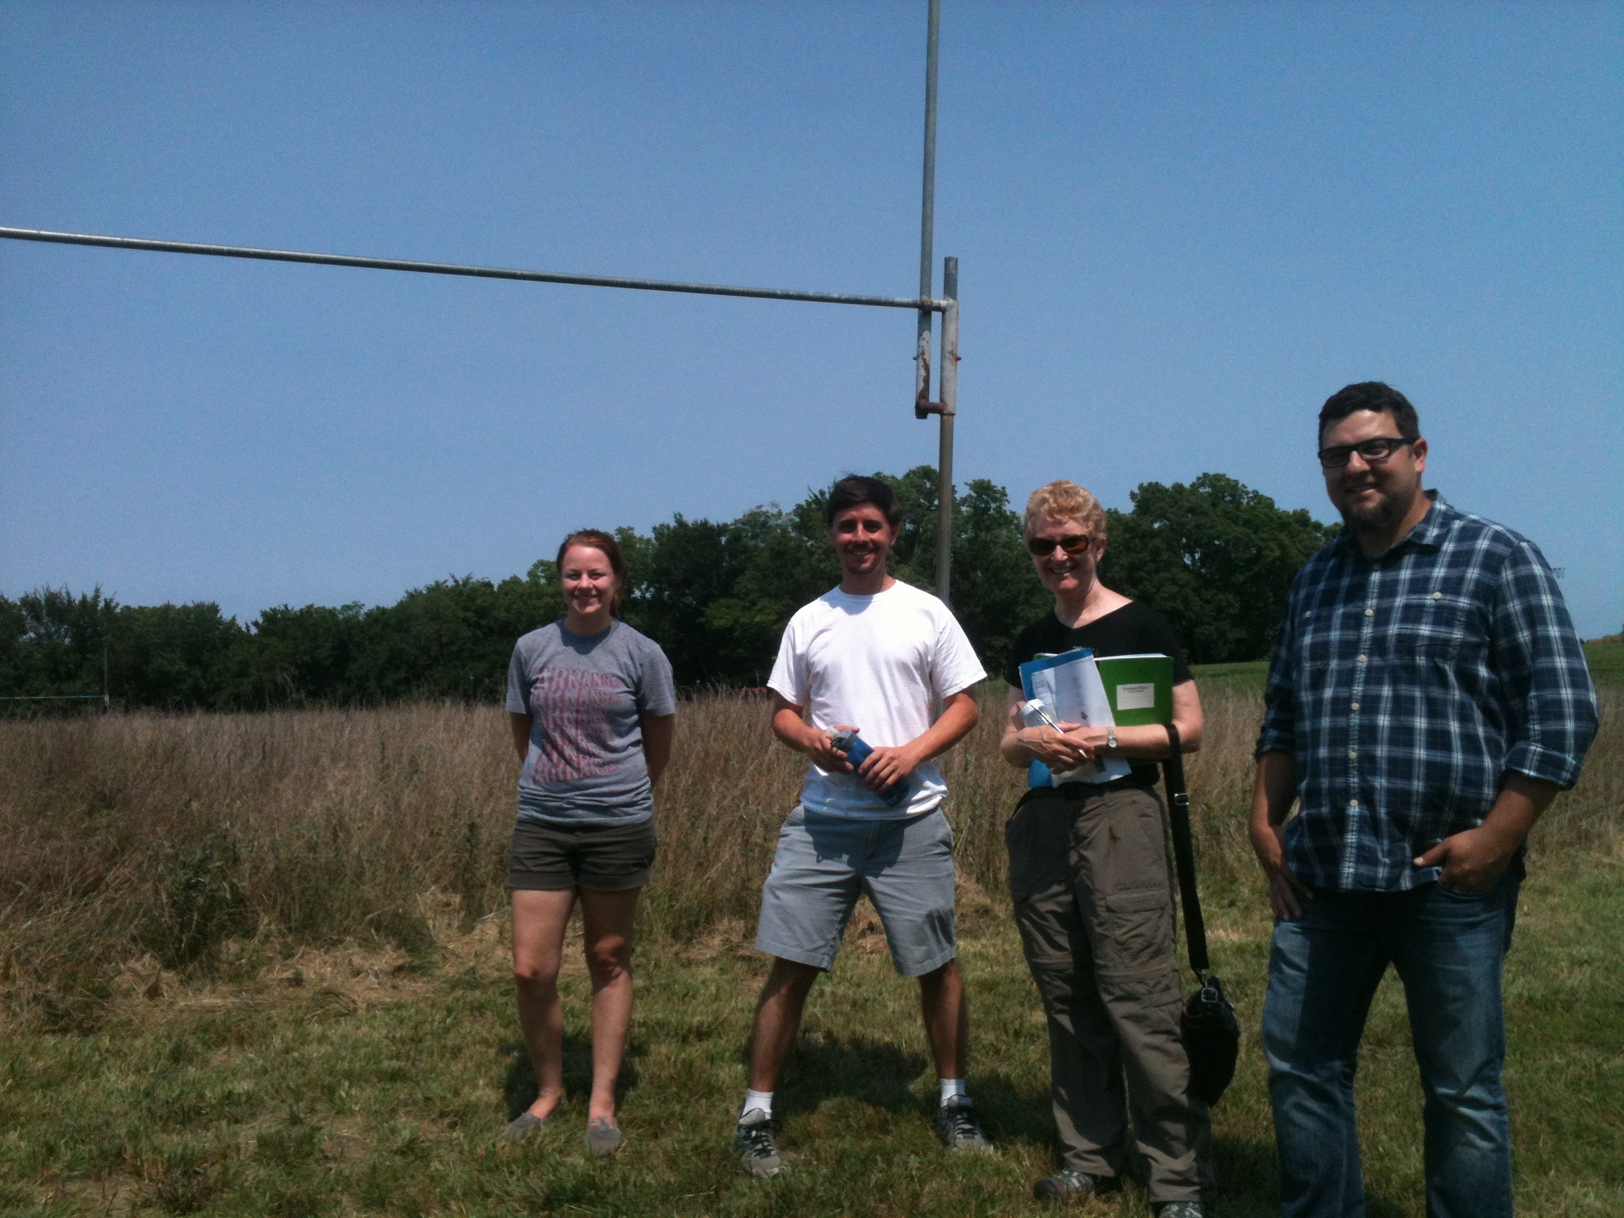
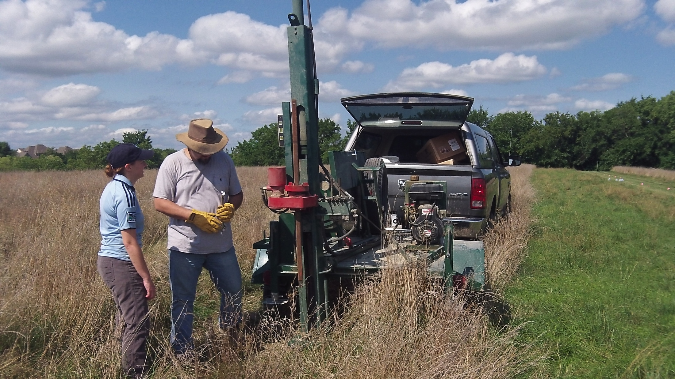
Lots of collaboration and decisions

Slide 14
Final plan
Can use treatments to
ask many questions
Baseline data taken:
soils, insects, plants
10 grass species, 20 forb species

Slide 15
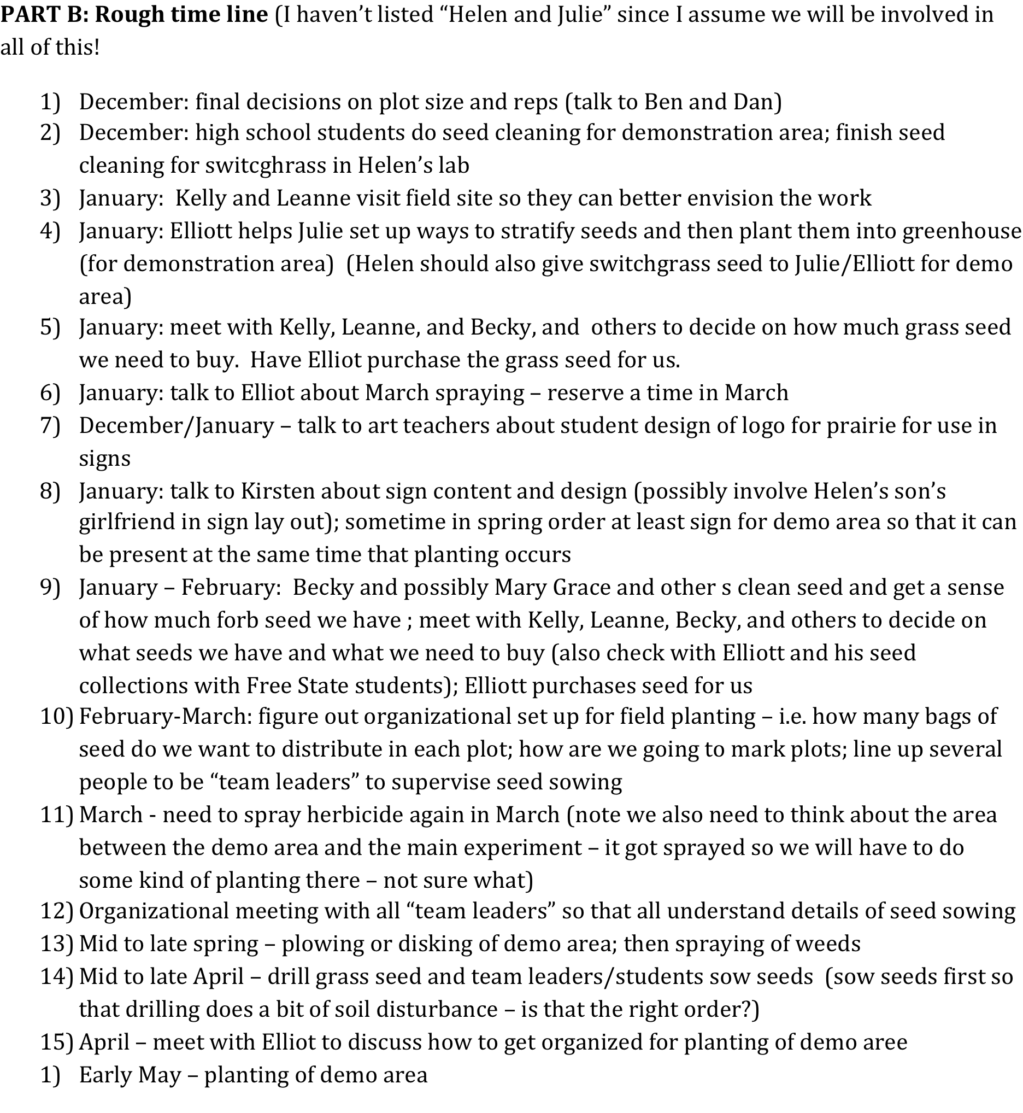

Slide 16
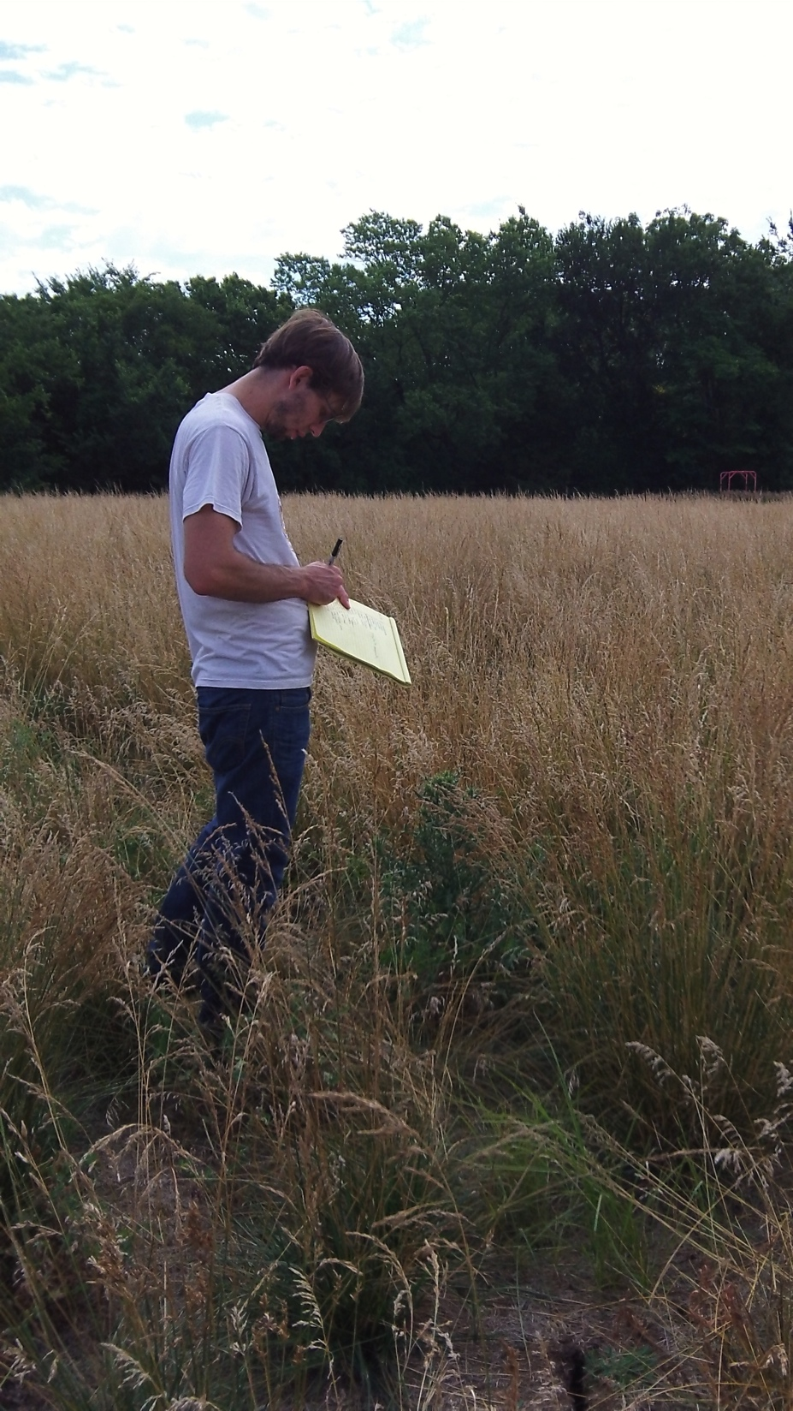
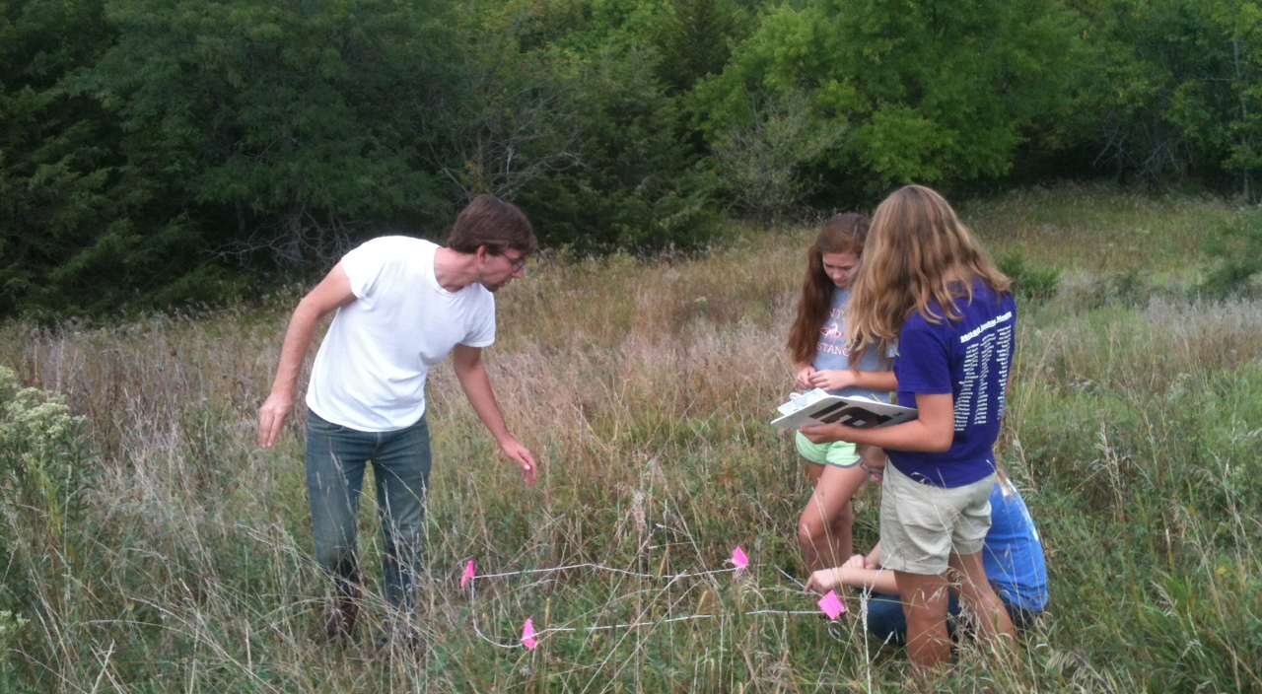
Baseline Plant Survey Late Summer 2013
Alex Bittel

Slide 17
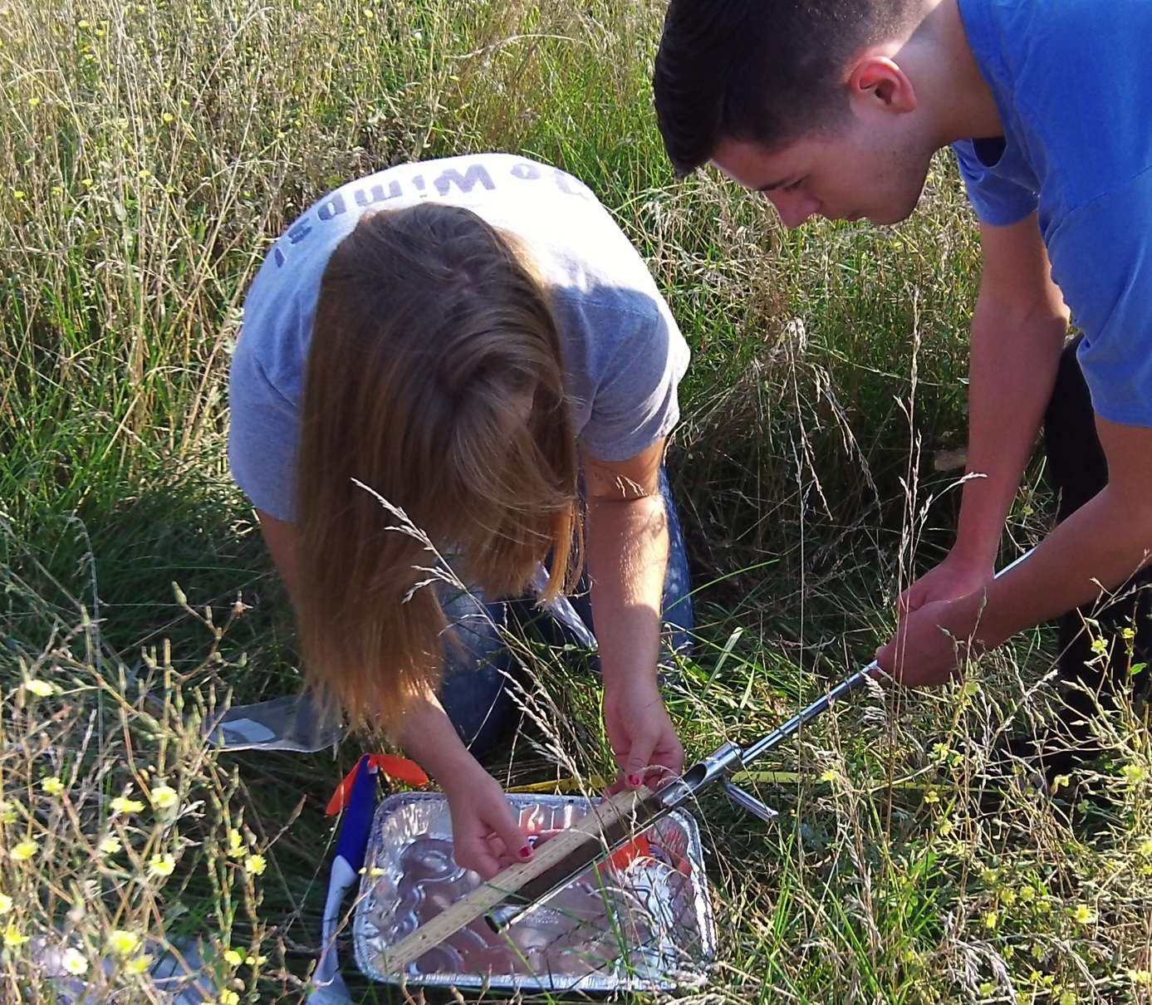
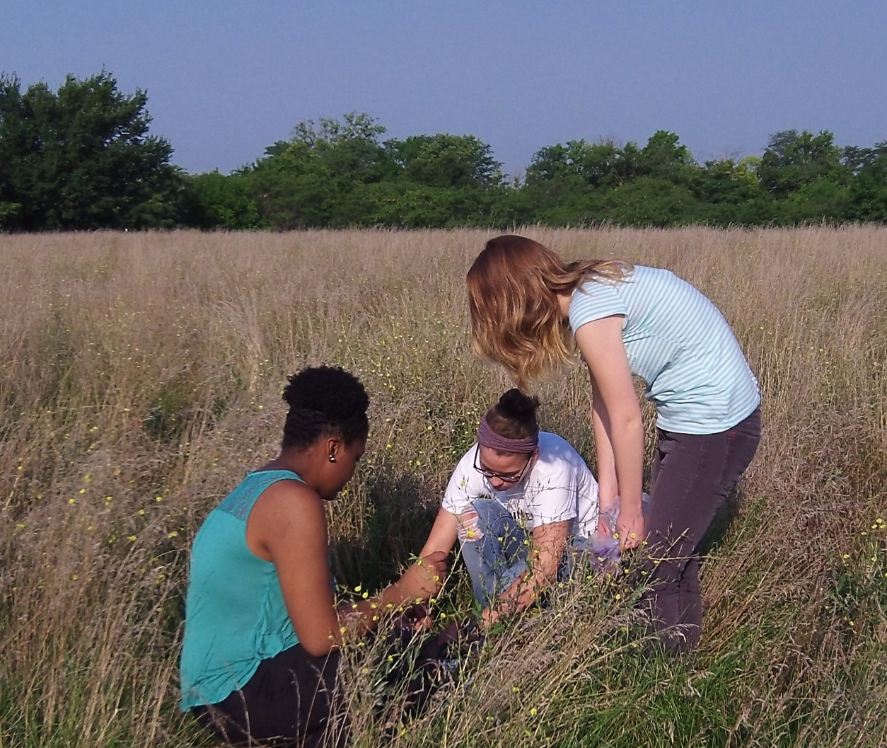
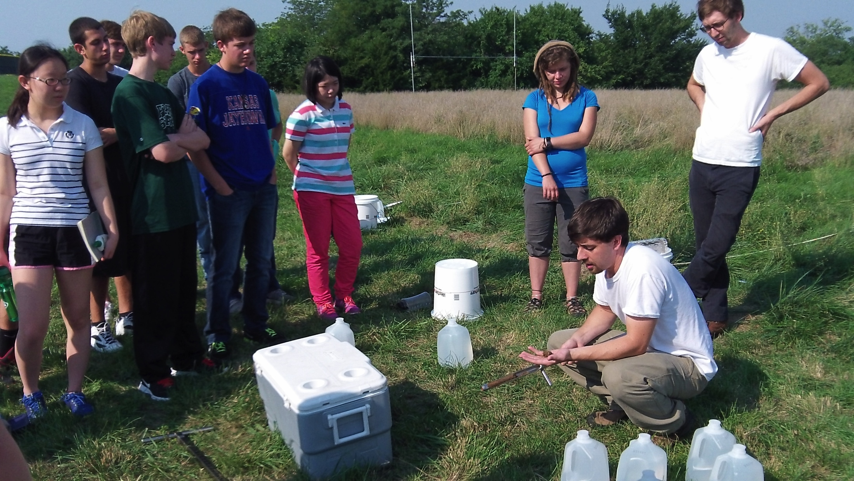
Fall 2013 Baseline Soil Sample

Slide 18
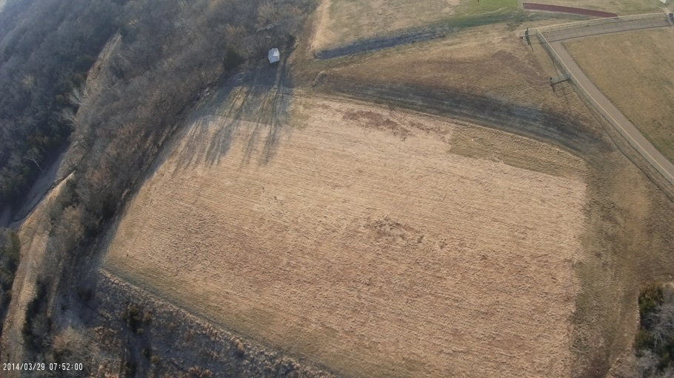
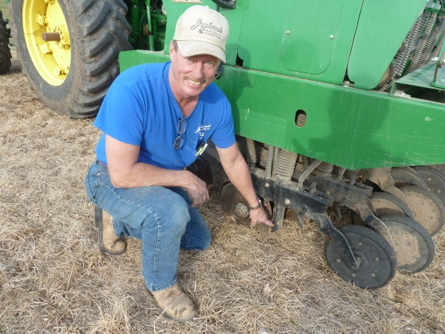
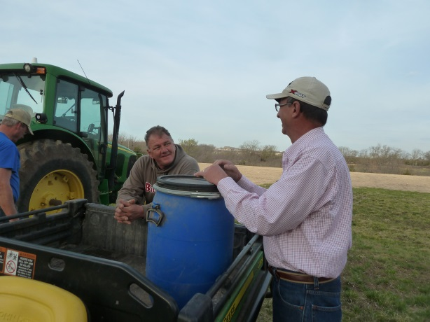
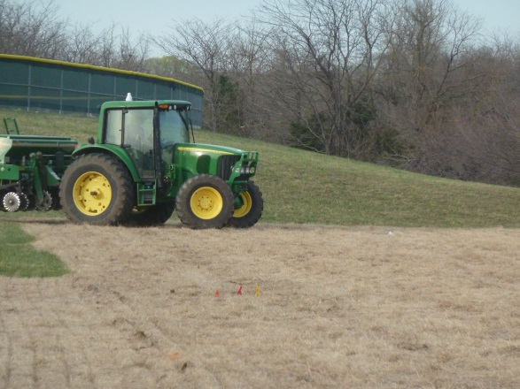
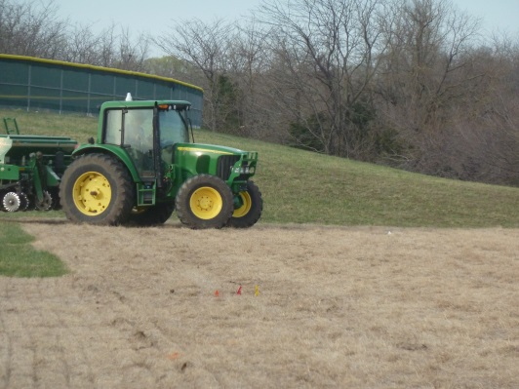
Experiment established in fall 2013/
spring 2014:
Step 1: Herbicide to kill the football field grasses (Fall 2013)
March 29 2014
Step 2: Plant prairie grass seeds across the entire site

Slide 19
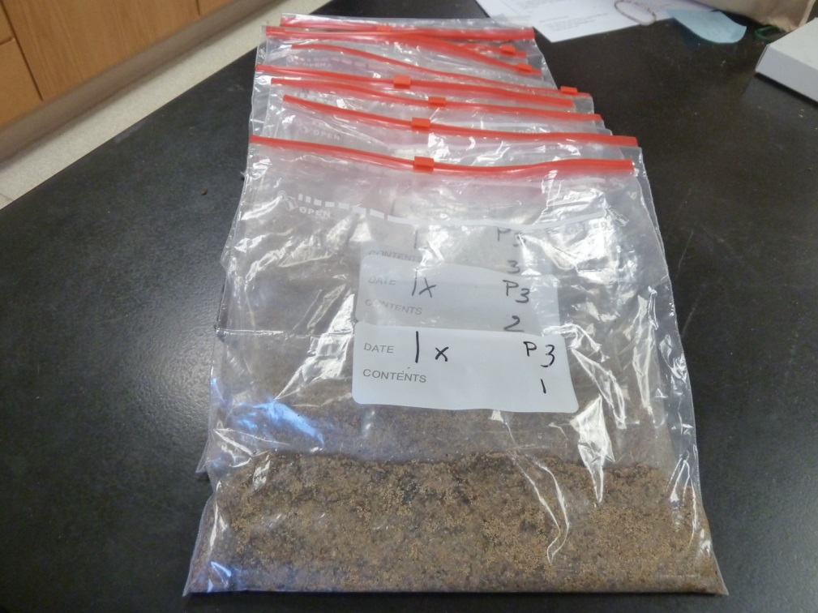
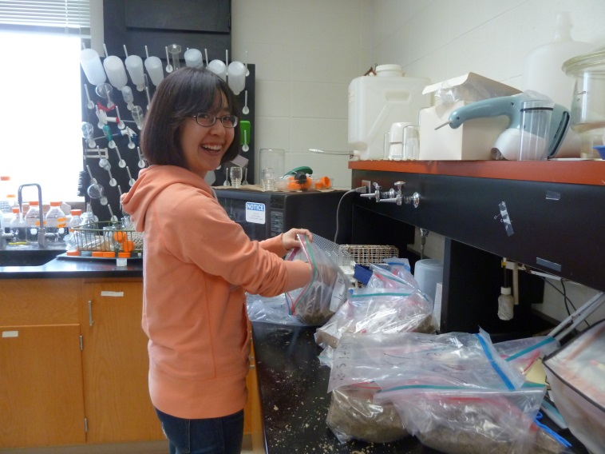
Step 3: Forb seeds organized and weighed;
sand added to seed mix to facilitate spreading

Slide 20
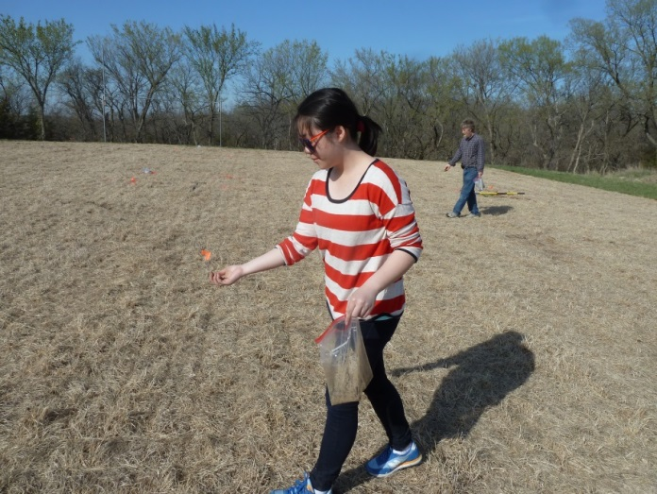
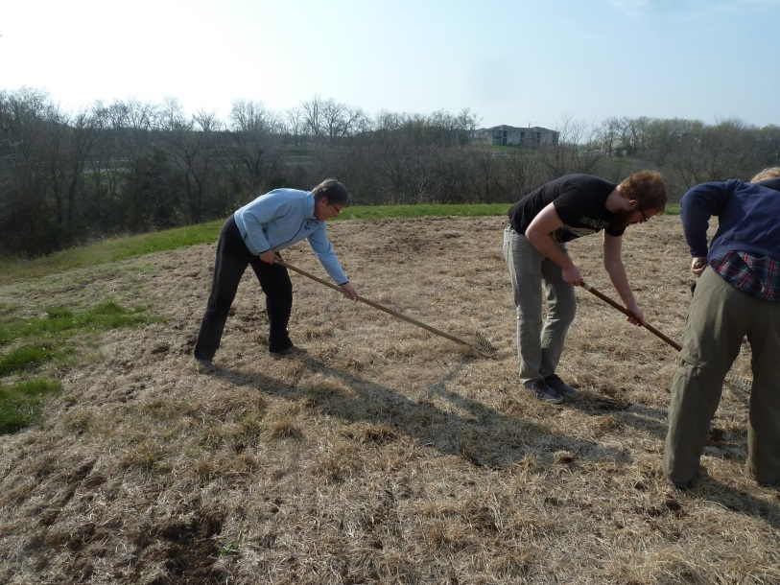
Step 4: Sow forb seeds (non grass herbaceous flowering plants
– “wildflowers”) by hand into two of the treatments
Step 5: Light raking (back side of the rake) of the entire site
to move forb seeds down to the soil surface

Slide 21
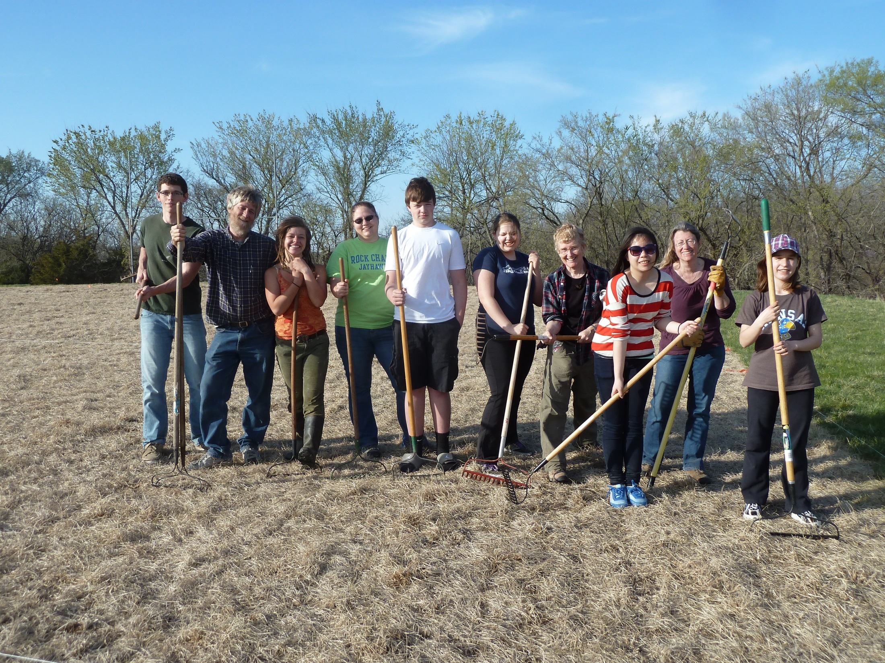
Many, many people helped

Slide 22
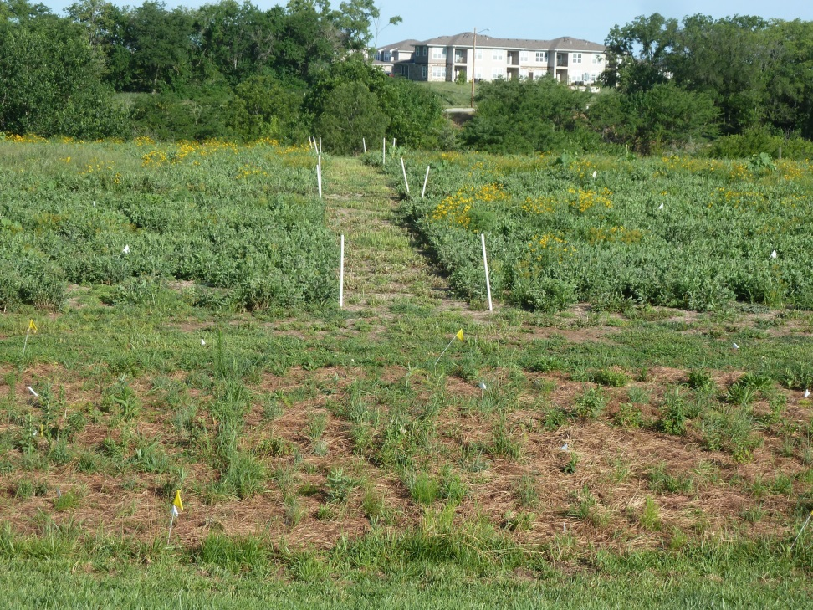
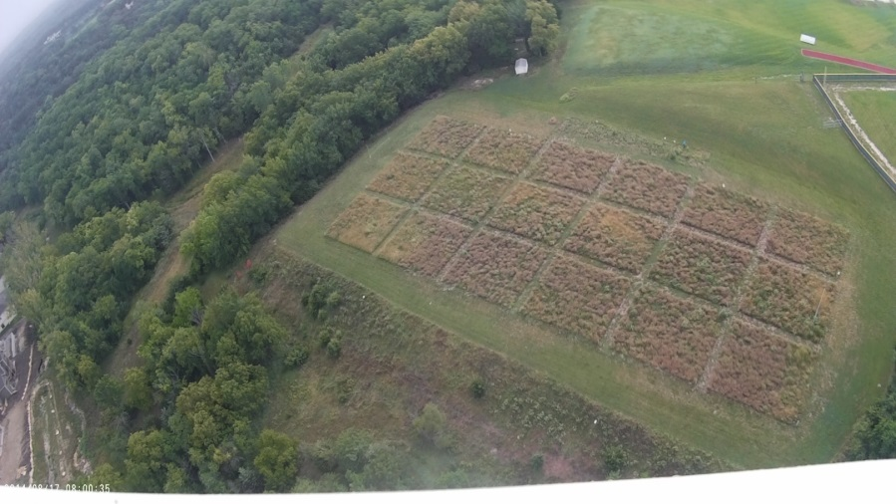
Summer: As expected, the site is full of weeds (whose seeds
were in the soil)
……….but we also are seeing many prairie plants establish
(have patience! – it will take at least three years before this
site starts to resemble a prairie)

Slide 23
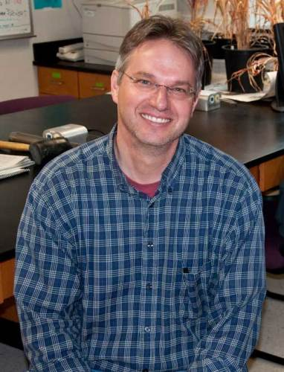
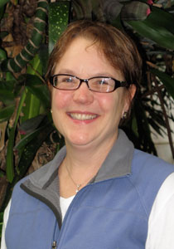
Also are using site for studies at
smaller spatial scales
Plant - soil microbe interactions
James Bever and Peggy
Schultz (Indiana University):
experts in this area
Visited KU spring 2014
Peggy initiated a FSHS
experiment as follow up of
Indiana study

Slide 24
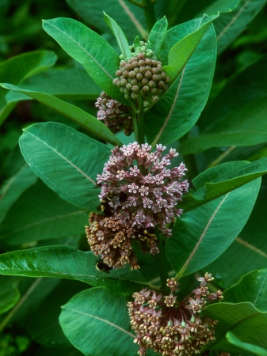
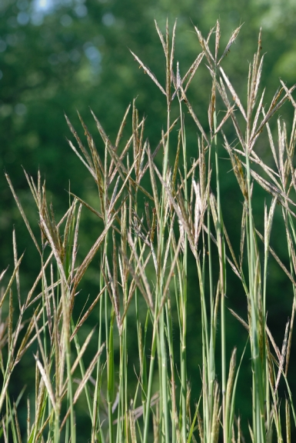
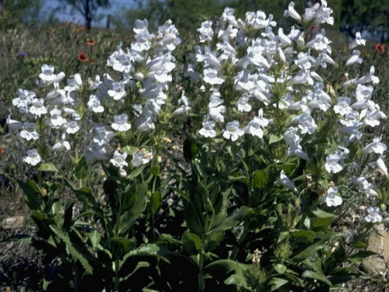
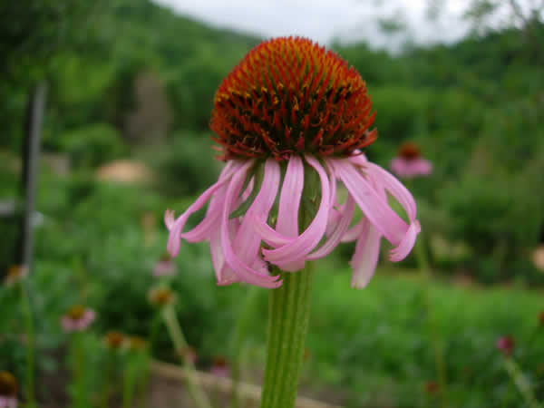
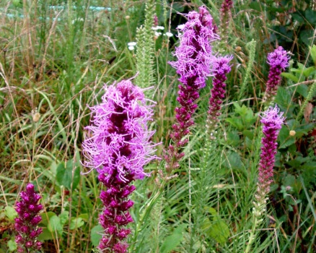
Question: does addition of prairie
soil affect establishment of plants
in restorations?
Wildflower.org
Vaplantatlas.com
Asclepias syrica
Penstemon digitalis
Mtcubacenter.org
Andropogon gerardii
Easywildflowers.com
www.prairiemoon.com
    Liatris pycnostachya)
Echinacea atrorubens

Slide 25
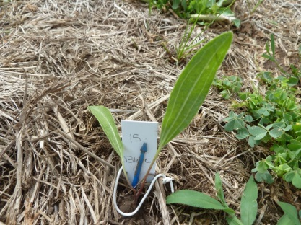
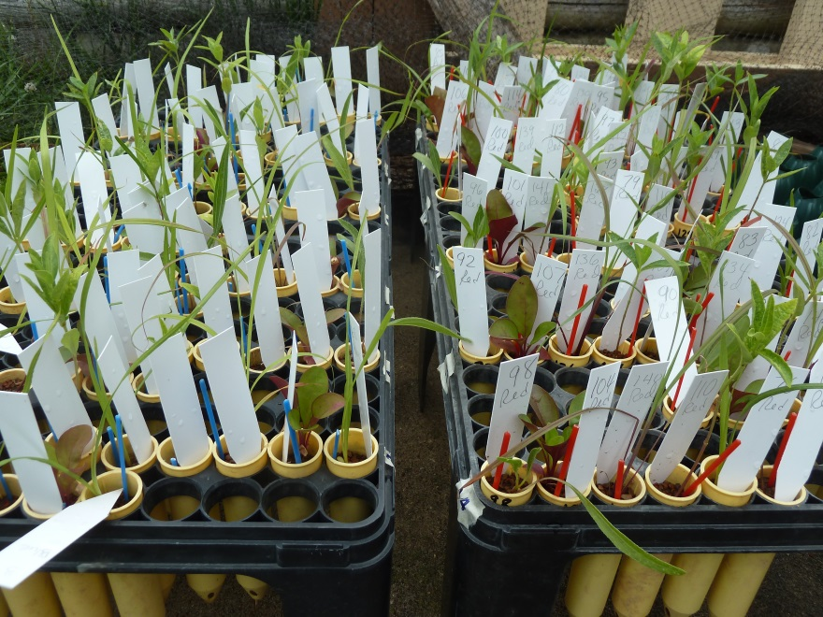
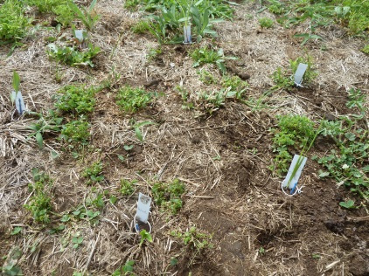
Grew plants from seed in KU greenhouse;
seedlings transplanted into small pots that were either
“uninoculated” (sterile field soil) vs. “inoculated”
(sterile field soil with added “live” prairie soil)
Plants then transplanted into Free
State Prairie Restoration Site (June 19, 20)

Slide 26
We can now address:
Does prairie soil inoculation have positive or negative
effects on the 5 transplanted species?
Does the presence of the transplanted species
with prairie soil alter establishment of the plants
sown from seed?

Slide 27
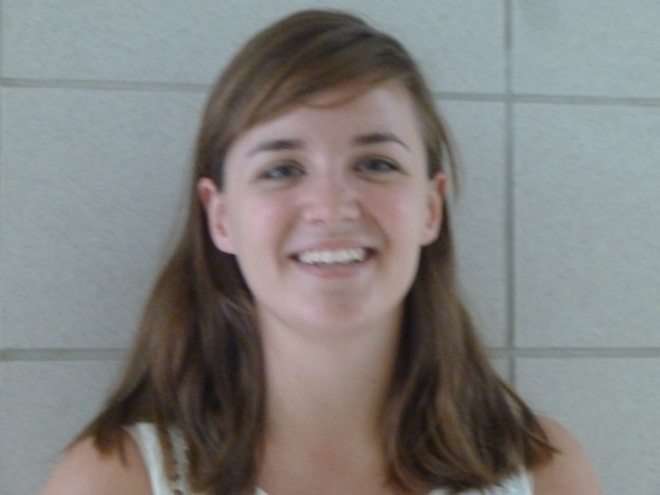
Over the summer, data recorded
on survival and plant size (height,
number of leaves, and length of
longest leaf)
Planting and field measurements
done by Sara Hettenbach
So far,
plants larger
in sterile soil

Slide 28
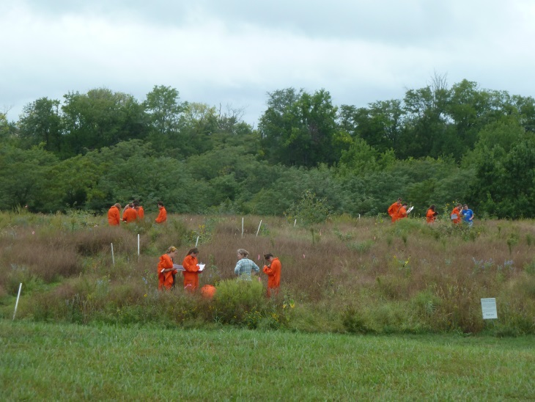
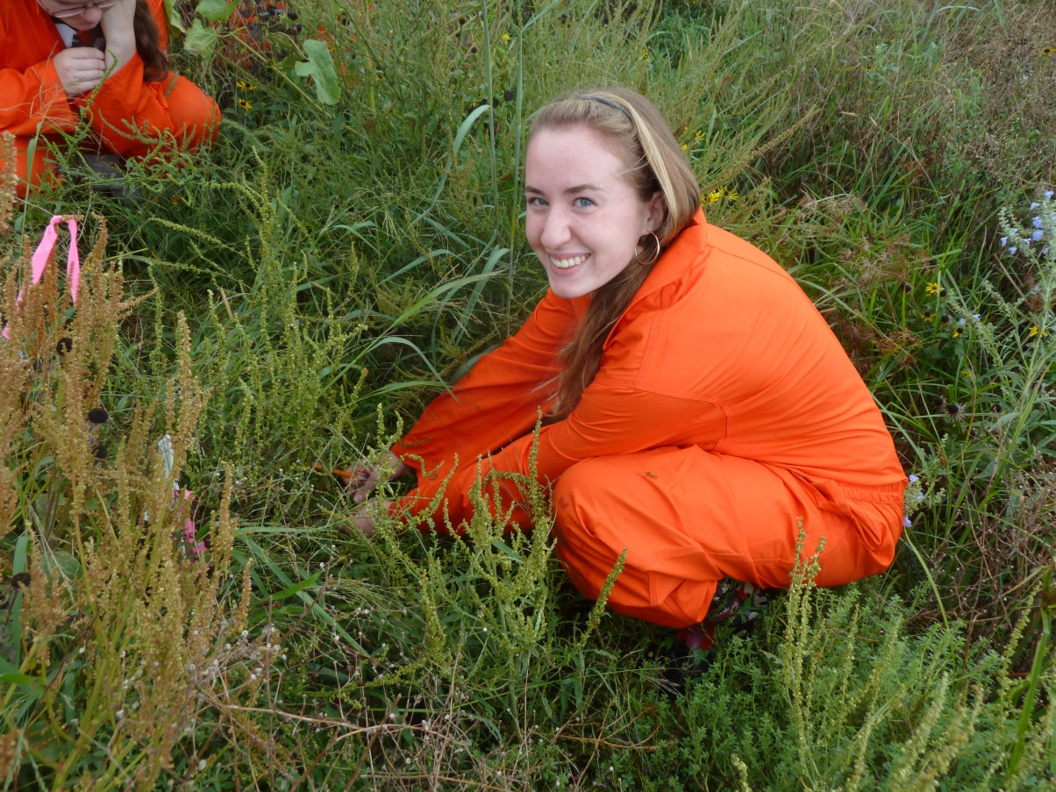
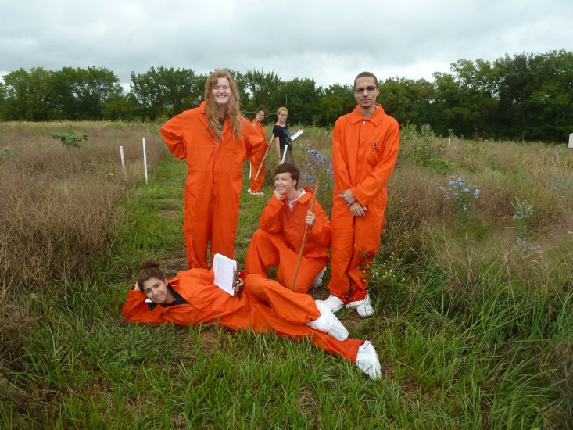
AP Environmental Science students took data
September 2014

Slide 29
Recall that we also created a second site:
A prairie restoration and community ecology
experiment in an abandoned football field
A prairie demonstration site
next to the prairie restoration/experiment
Goal: “instant” prairie – education and outreach

Slide 30
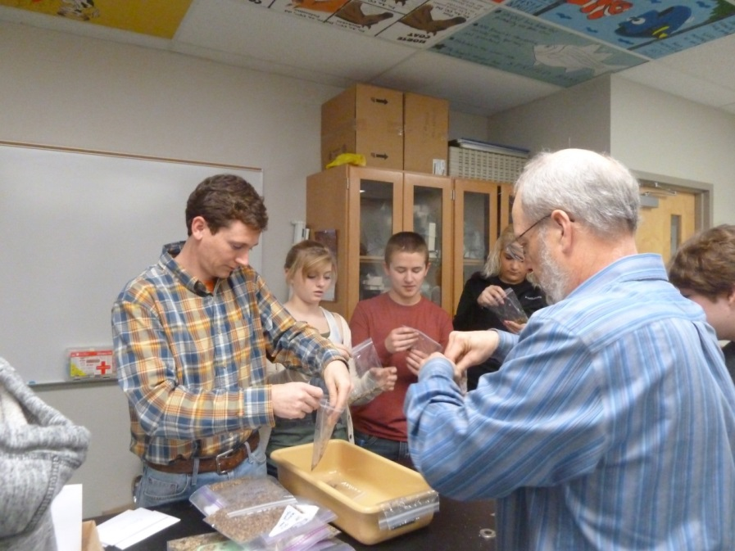
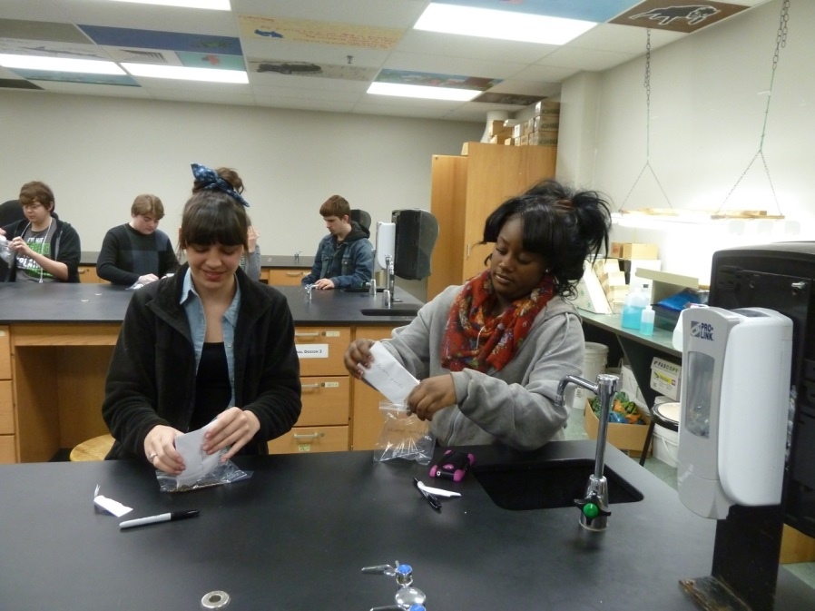
Step 1: Prairie seed collections with FSHS and KU classes
(Fall 2013); other seed purchased
Step 2: Elliott Duemler (Applied Ecological Services) taught
students how to prepare seed for germination

Slide 31
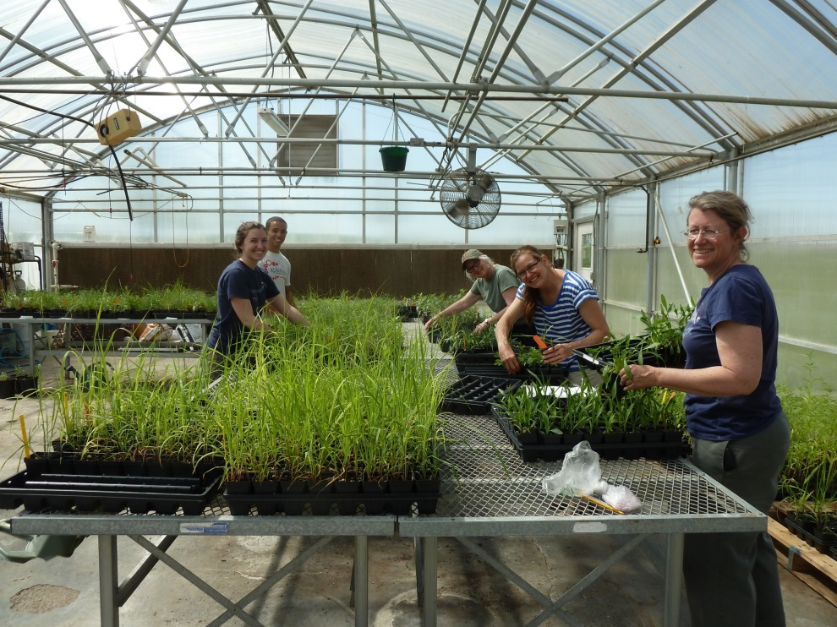
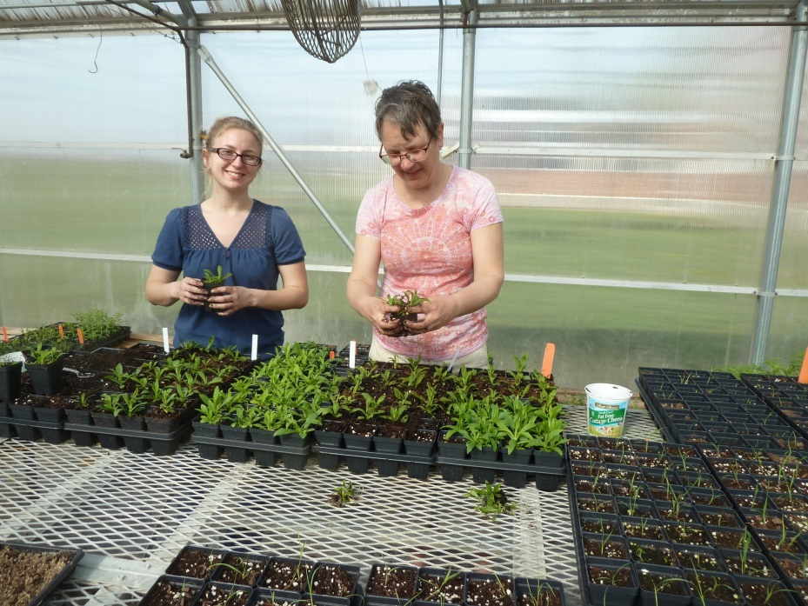
Step 3: Growing plants in the greenhouse..

Slide 32
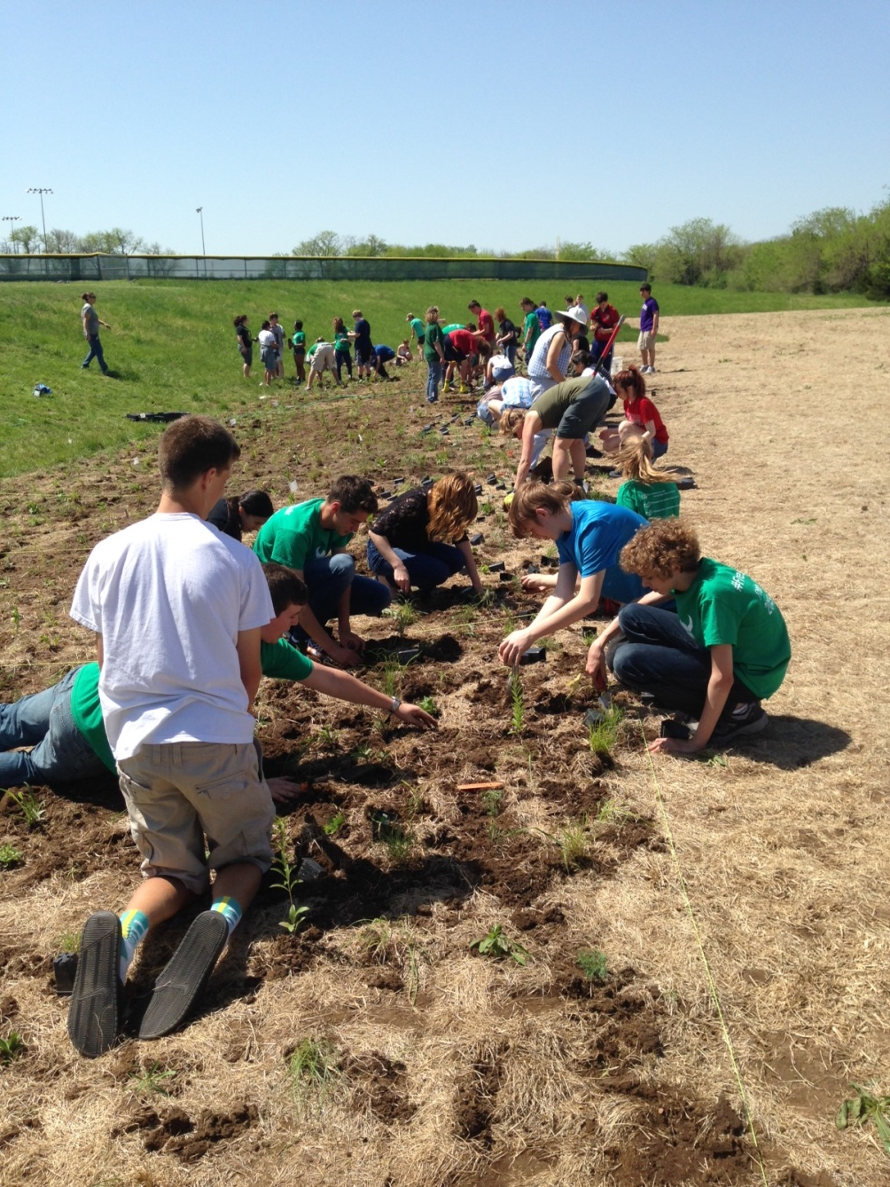
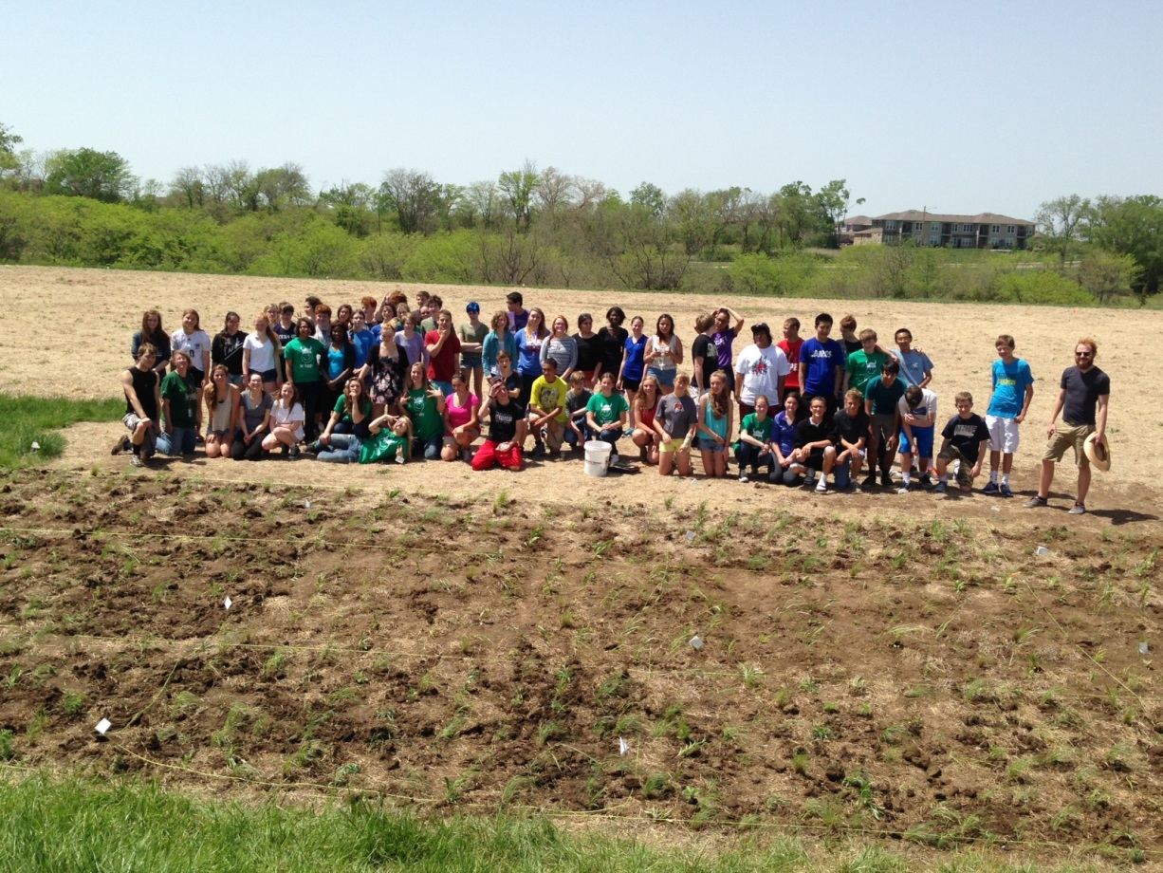
Step 4: Transplanting at
the field site
8 grass species, 33 forb species

Slide 33
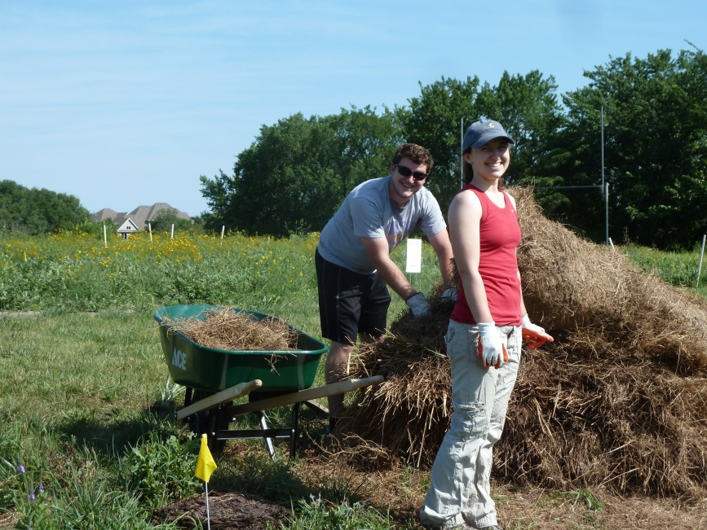

Step 5: Weeding and mulching (all are welcome to join us!)
Early July 2014
Aug 17 2014

Slide 34
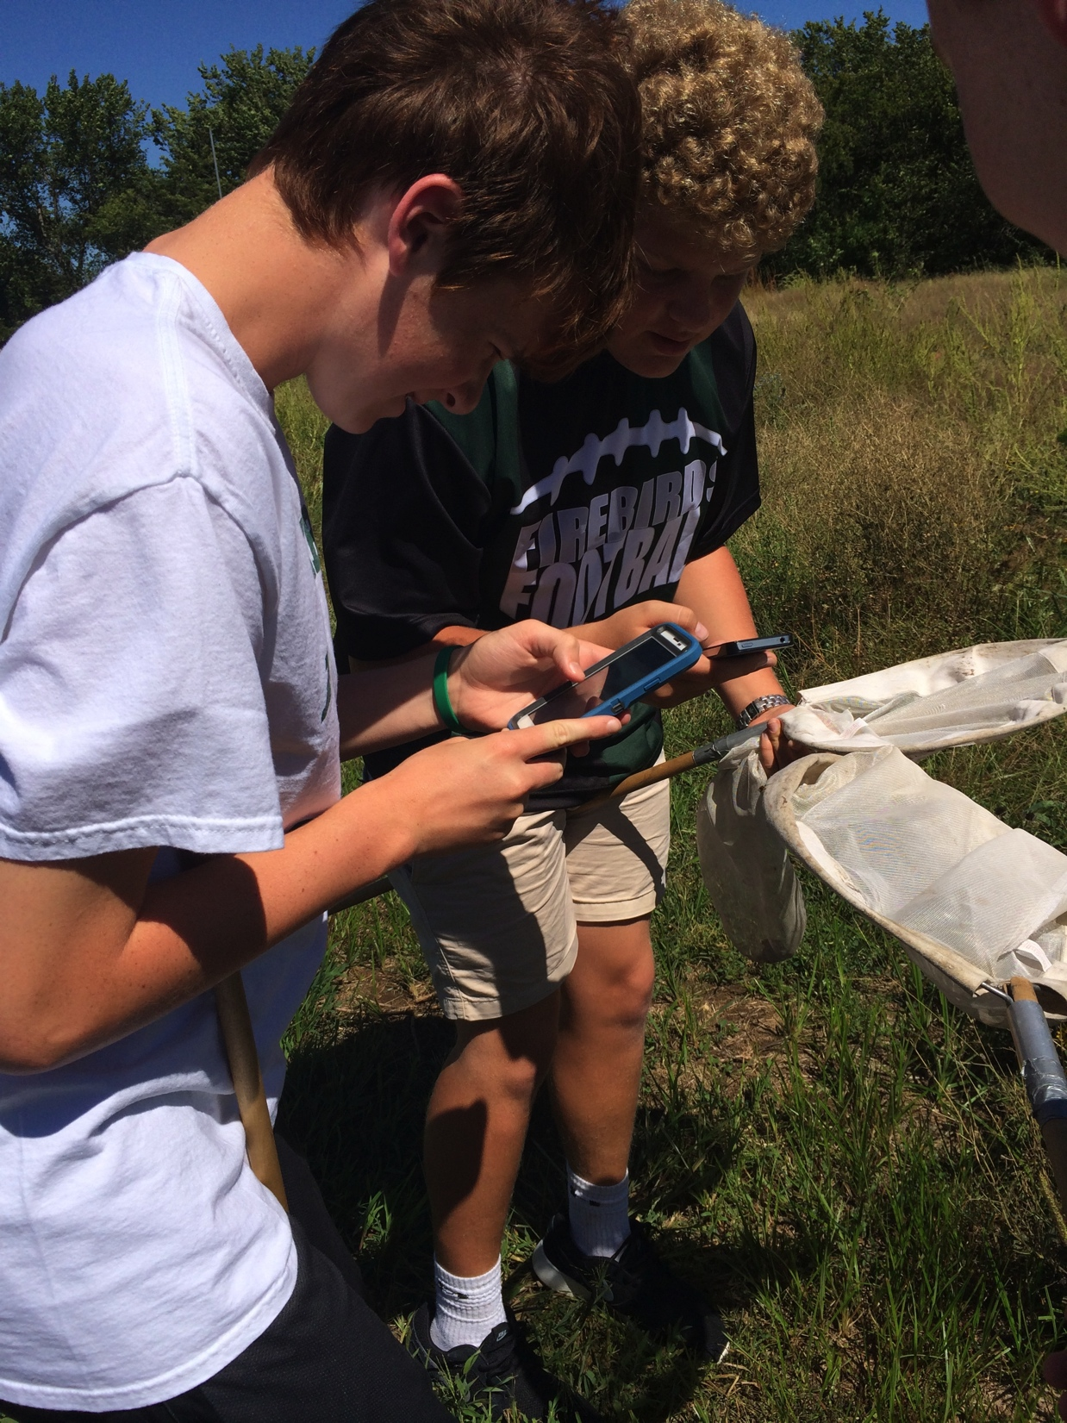

Current and future plans
Free State design and shop classes weld informational signs and build shelter, art students paint shed, journalism students publish plant guide online, develop Free State Prairie website
Bluebird houses
Ground nesting bee boxes
Small mammal track tubes
Endless possibilities!

Slide 35

Ongoing KU collaboration and outreach to middle/elementary schools!

Slide 36
Acknowledgments:
Elizabeth Schultz Environmental Fund
Applied Ecological Services, Inc. (Elliott Duemler)
Kansas Department of Wildlife, Parks, and Tourism
(Brad Rueschoff)
Douglas County Conservation District (Jim Weaver)
Kansas Biological Survey and the University of Kansas
Field Station
(many people, especially Kelly Kindscher)
Lawrence Public Schools (many people)
University of Kansas (many people)
Indiana University (Peggy Schultz)
Grassland Heritage Foundation
Many, many community volunteers

