Slide 1
Going Gradeless
Kelly Kluthe
Wyandotte High School, Kansas City, KS

Slide 2
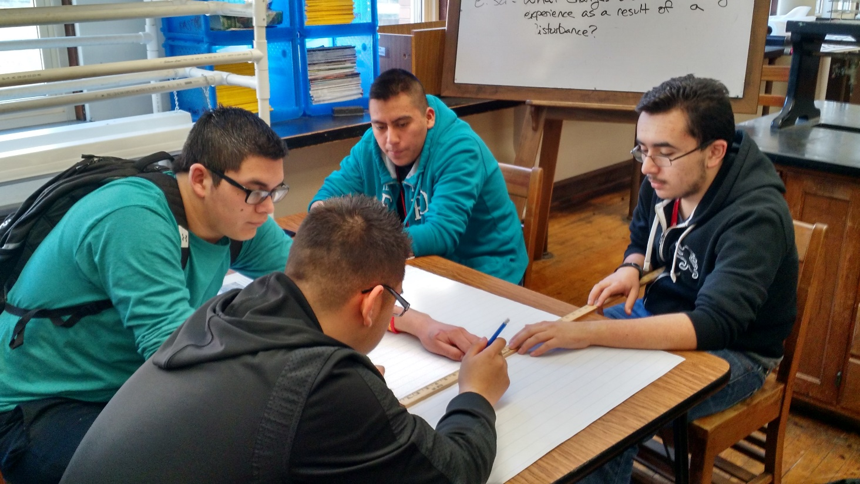
What is a gradeless classroom?
A “gradeless classroom” essentially takes standards-based grading, but doesn’t assign a percentage or letter grade to student performance
Students are given feedback on their work and are allowed to re-do assignments and retake tests until mastery

Slide 3
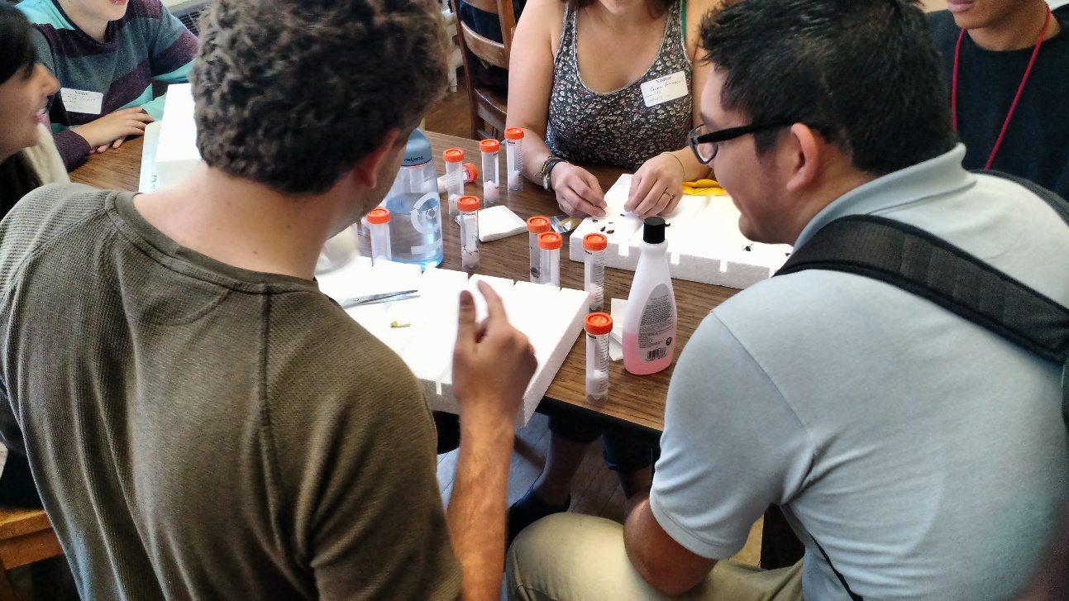
Why go gradeless?
Shifts focus from student compliance to student learning
Takes stress off of students to achieve a certain letter grade
Fewer students come to me asking “What can I do for extra credit”, or “What do I need to do to receive a C?”

Slide 4
What does a gradeless classroom look like?
Use of gradebook:
I use my gradebook to keep track of what assignments students turn in
On shorter practice assignments, students receive a C (complete), I (incomplete), or M (missing).
On labs and larger assignments students receive a 0-4 rating with feedback (more on this later)
Student reflection:
1-2 times a week, students write reflections in their lab notebooks (what are the main ideas, why is this important, how confident are you in your learning?)
Students keep their completed work in folders to document their mastery

Slide 5
Scales and Feedback
Assignment Evaluation Scale
4.0 | I know it even better than my teacher taught me. Shows above and beyond understanding I can teach somebody else I made no mistakes
3.0 | I know it just the way my teacher taught me. I met the objectives of the lesson I can do this on my own
2.0 | I know some of the simpler stuff, but can’t do the harder parts. I know vocabulary and can show basic skills I need more practice
1.0 | With some help, I will be able to do this. I need more practice I don’t understand this yet
0.0 | Even with help, I can’t do this, or I didn’t turn in my work. I didn’t try to use Literacy Strategies to decode

Slide 6
Scales and Feedback
0 1 2 3 4 |  | 0 1 2 3 4
Evidence of Learning | Areas of Concern | Evidence of Learning | Areas of Concern

Slide 7
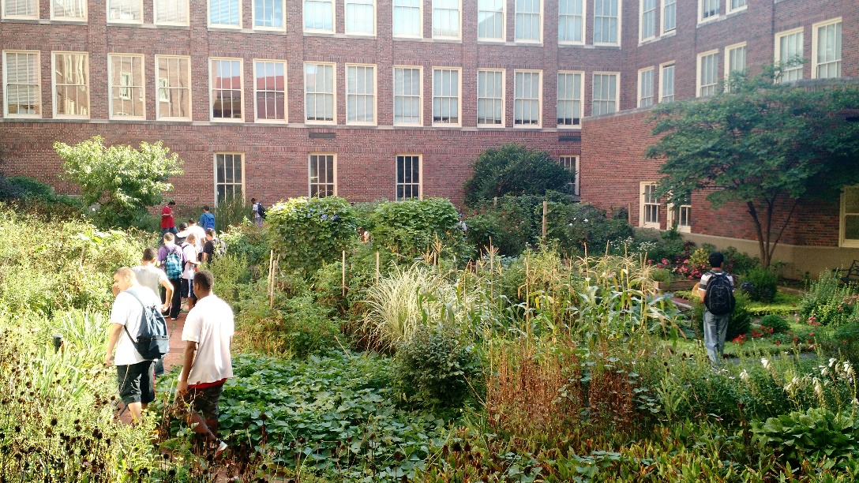
Assessment of Student Knowledge
Tests are differentiated based on student skill level
Level 2, Level 3, and Level 4 tests are offered
Level 2 – Basic skills, vocabulary
Level 3 – Application
Level 4 – Open-written response
Students are allowed to test at the level they are comfortable at
Students may stay after school to retake a test at a different level
For more: Talk to Steve Young at Olathe East

Slide 8
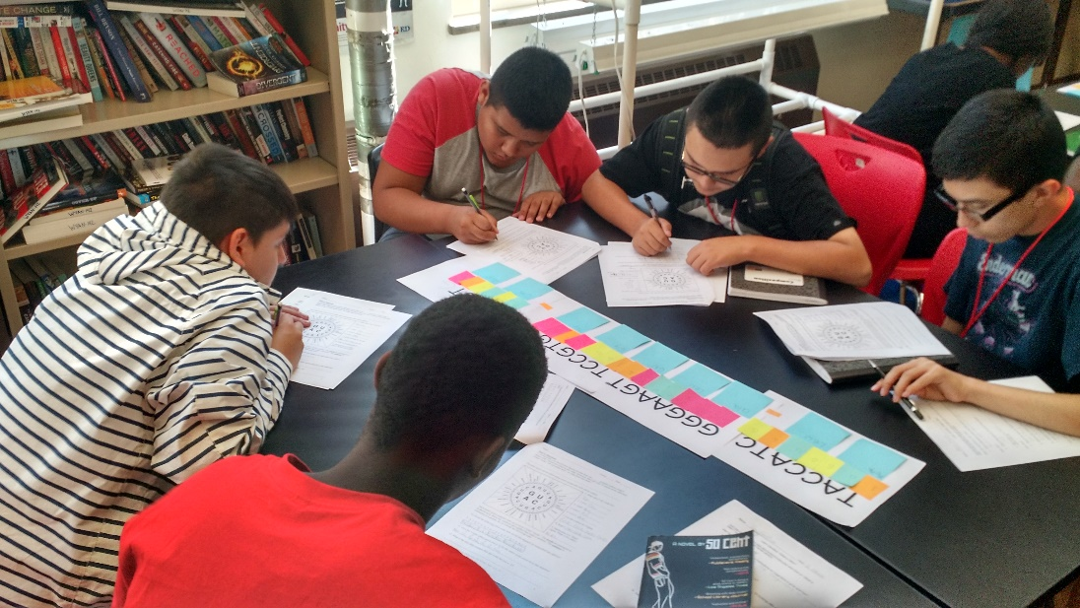
Making a gradeless classroom work
I am, however, still required to submit letter grades for progress reports
Before submitting grades, I hold a short conference with each student individually to determine which letter grade they think they deserve
Students much provide evidence to back up their claim
I hide percentages from students and parents in my gradebook

Slide 9
Thoughts so far
Students took a while to trust me and are still learning the system
Our first test and conference went well
Most students attempted level 2 or level 3 tests, many were successful
Students are planning to come in after school to try different levels
My grade recommendation and the student recommendation was almost identical every time
I need a better way to manage student progress in the gradebook
Current method hurts athlete eligibility

